Slide 1
Lesson 4.3
Understanding Climate Change
www.tu.org/headwaters
© 2025 Trout Unlimited. Any use of the text or images this document contains without permission of 2025 Trout Unlimited is prohibited.

Slide 2
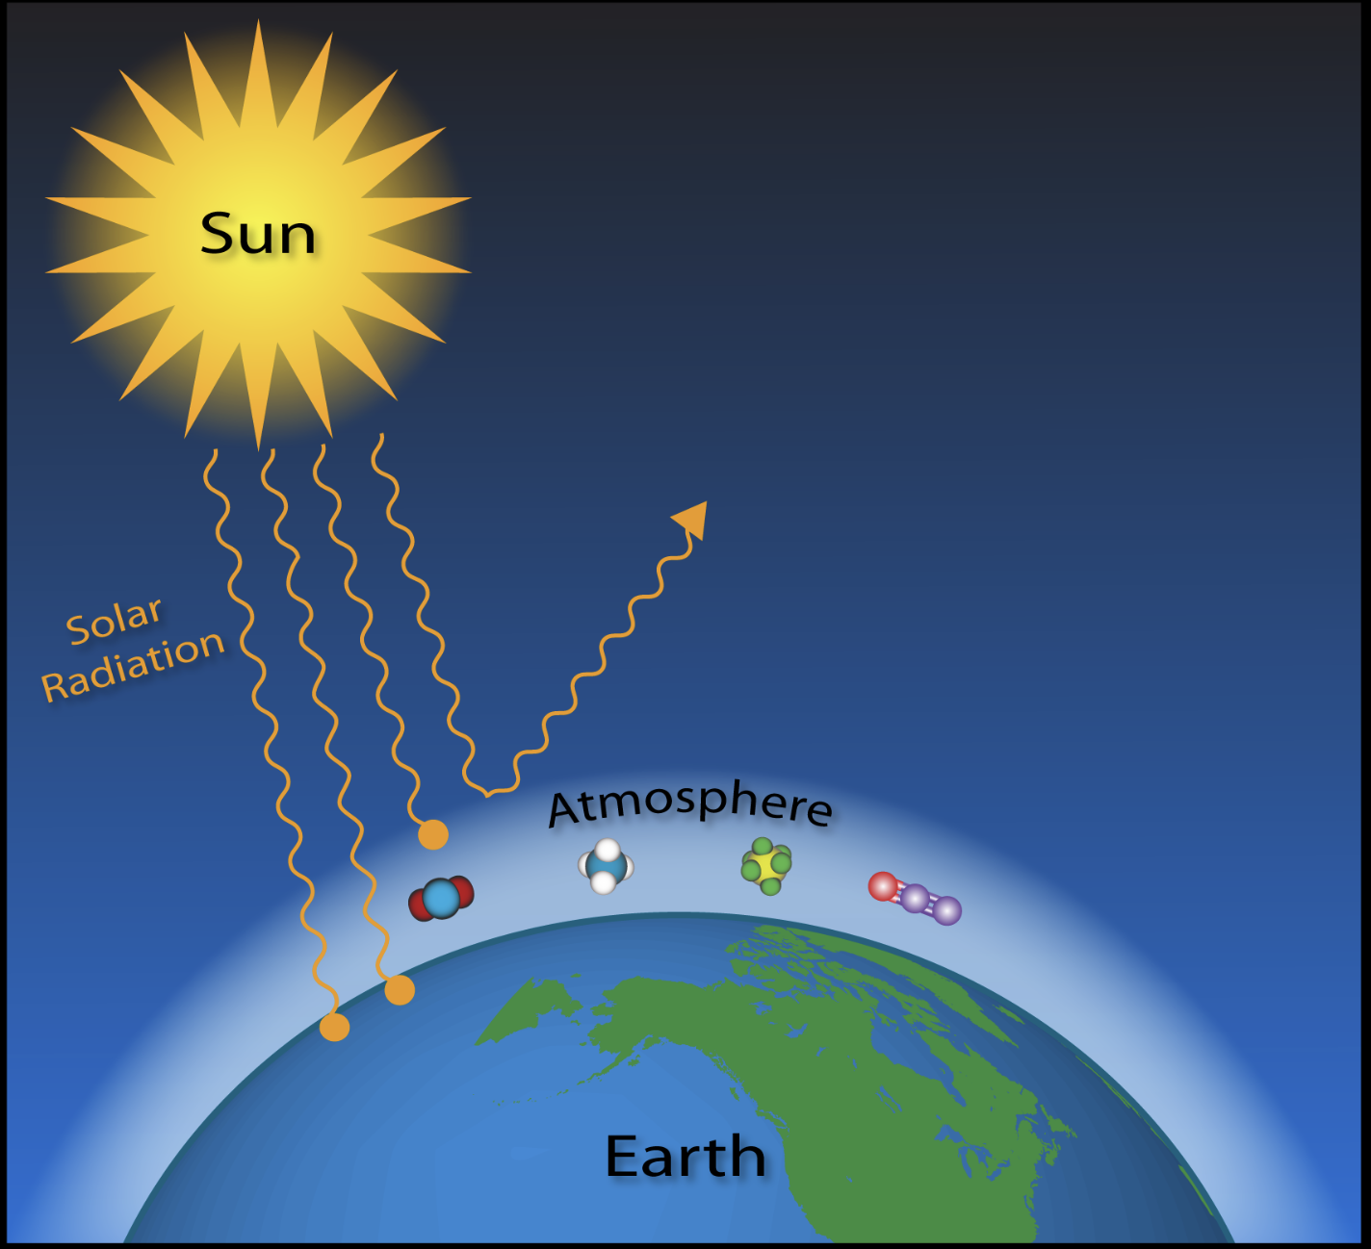
Greenhouse effect
The greenhouse effect is a natural process by which certain gases in the atmosphere absorb infrared radiation (heat) that is emitted from the earth and sun. This warms the atmosphere and planet’s surface.
Greenhouse gases include: carbon dioxide, methane, some nitrogen oxides and water vapor
Credit: Barb Deluisi, NOAA

Slide 3
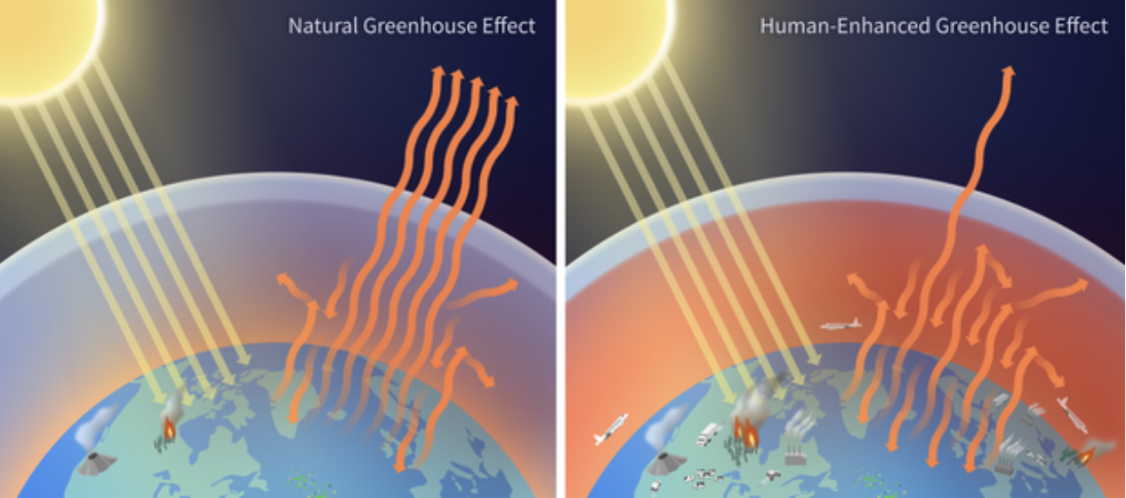
Enhance greenhouse effect
The enhanced greenhouse effect is a magnification of this process due to the anthropogenic increased emissions of greenhouse gases, primarily carbon dioxide and methane.
Credit: NOAA Climate Program Office, Graphic by Anna Eshelman

Slide 4
Anthropogenic CO₂ emissions
Combustion of fossil fuels is one of the most significant sources of anthropogenic greenhouse gas emissions.
Carbon is stored over the long term (100 millions of years) inside of sedimentary rocks made of buried plant and animal material in the form of coal, oil and natural gas.
When humans mine and then combust fossil fuels for energy, carbon dioxide is released in the atmosphere at much greater rates than can be absorbed by natural processes such as photosynthesis.
This increases levels of atmospheric CO₂, which absorbs more infrared radiation and causes climate change.

Slide 5
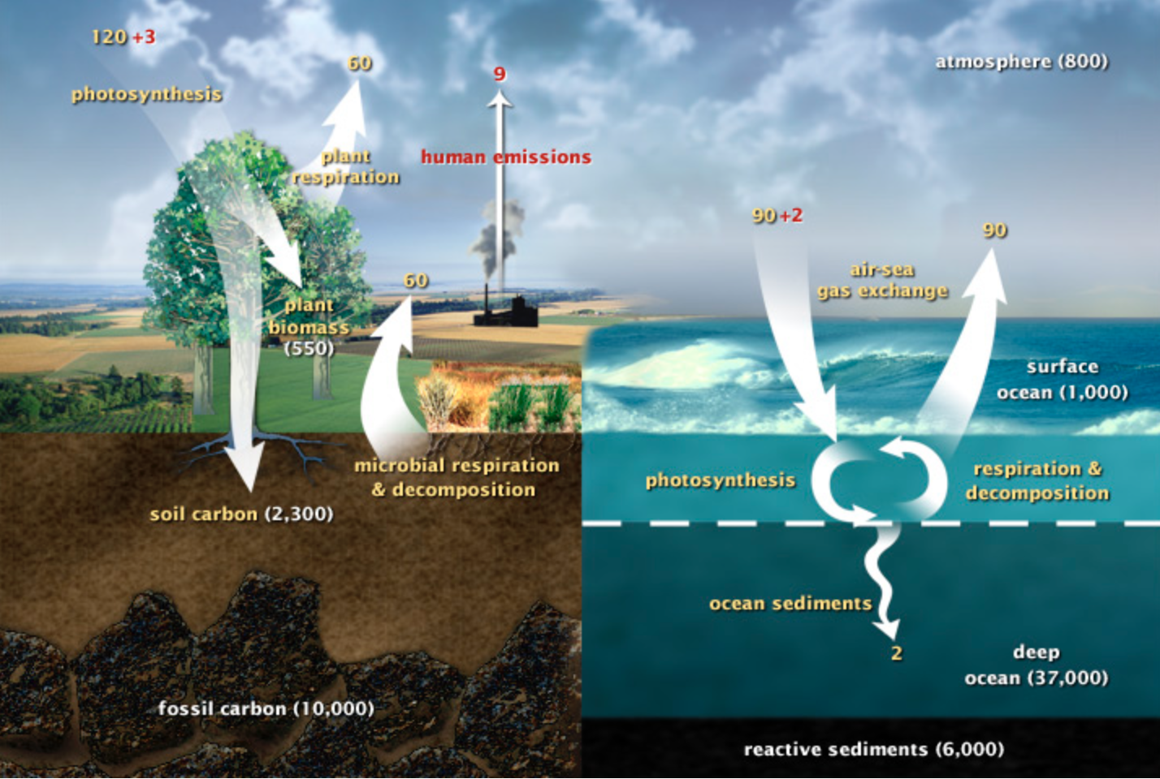
Carbon cycle diagram
Credit: NASA Earth Observatory, Graphic by Robert Simmon

Slide 6
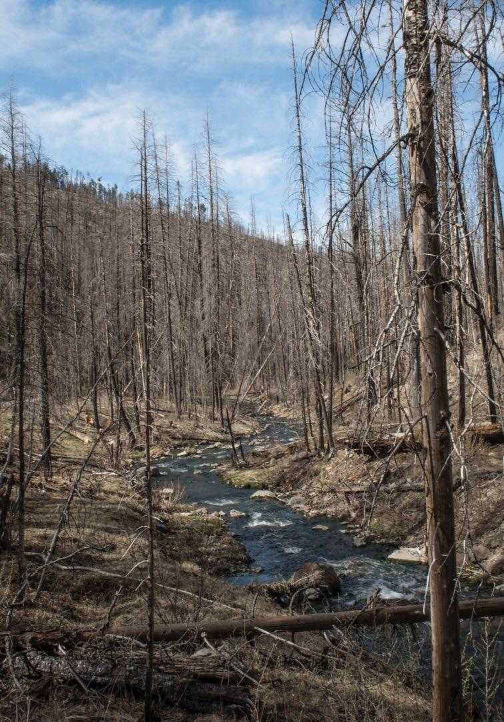
Global effects of climate change
This enhanced greenhouse effect is causing the global climate to change, including:
Overall global air temperatures increasing.
Changes in precipitation patterns including increased droughts in some areas and increased precipitation in others.
More intense storms in terms of rainfall and wind speed.
Overall ocean temperatures rising, causing thermal expansion and sea level rise.
Ice caps melting.
© 2017 Josh Duplechian, Trout Unlimited

Slide 7
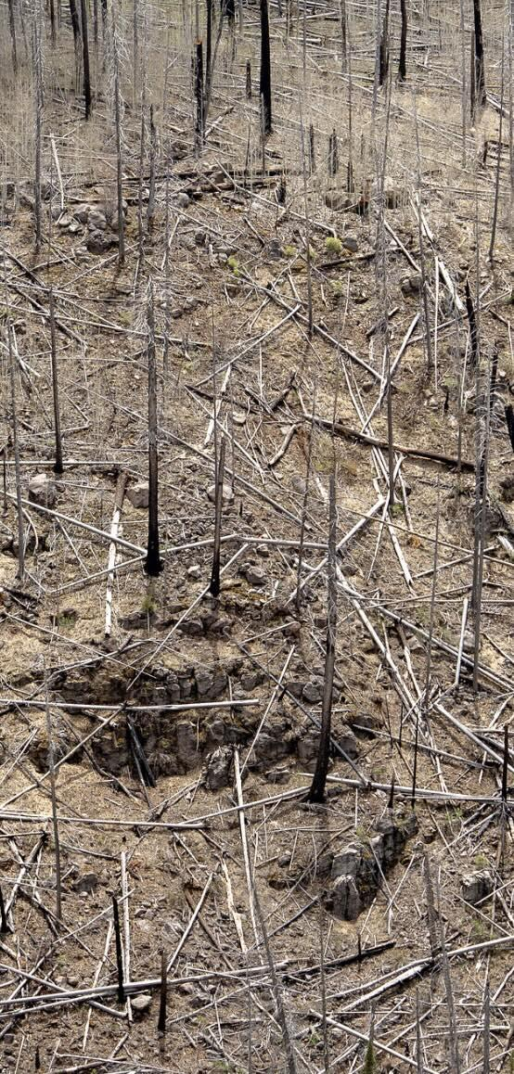
Effects of climate change on rivers
Climate change can have a particularly detrimental effect on river habitats and trout in particular. Possible harms include:
Higher water temperatures stress or kill cold water species like trout.
Higher water temperatures can allow the introduction of invasive species that outcompete trout.
Reduced precipitation leads to drought and low water discharge rates.
More intense storms can cause more frequent flooding events that can disrupt habitat.
Some rivers are fed by glaciers which may disappear.
© 2023 Josh Duplechian, Trout Unlimited

Slide 8
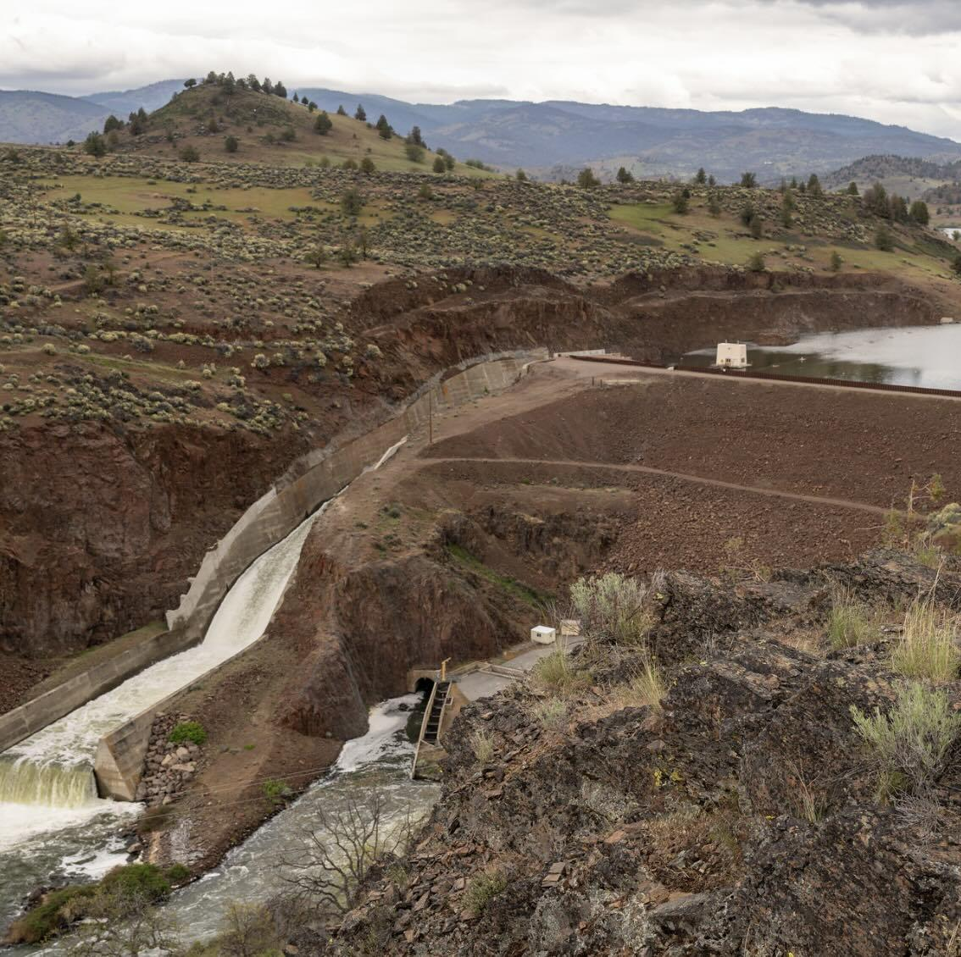
Climate change adaptations
Steps taken to make habitats or people more resilient to climate change is called adaptation. Many adaptations for more resilient river habitats are possible, including the following:
Connect rivers and headwaters so fish can move to find thermal refuges (places with cooler water temperatures during heat events).
Increase riparian planting to maximize shade.
Reduce the number of dams which can increase water temperatures and evaporation in reservoirs.
Reduce the number of water diversions to keep the maximum amount of water in rivers for fish.
© 2023 Josh Duplechian, Trout Unlimited

Slide 9
Climate change mitigation
The most fundamental way to address climate change impacts is to attack the root cause by slowing the release of additional greenhouse gases into the atmosphere.
The strategy of fighting climate change by addressing the cause is called climate change mitigation.

