Slide 1
Lesson 4.2
Understanding Invasive Species
www.tu.org/headwaters © 2025 Trout Unlimited. Any use of the text or images this document contains without permission of 2025 Trout Unlimited is prohibited.

Slide 2
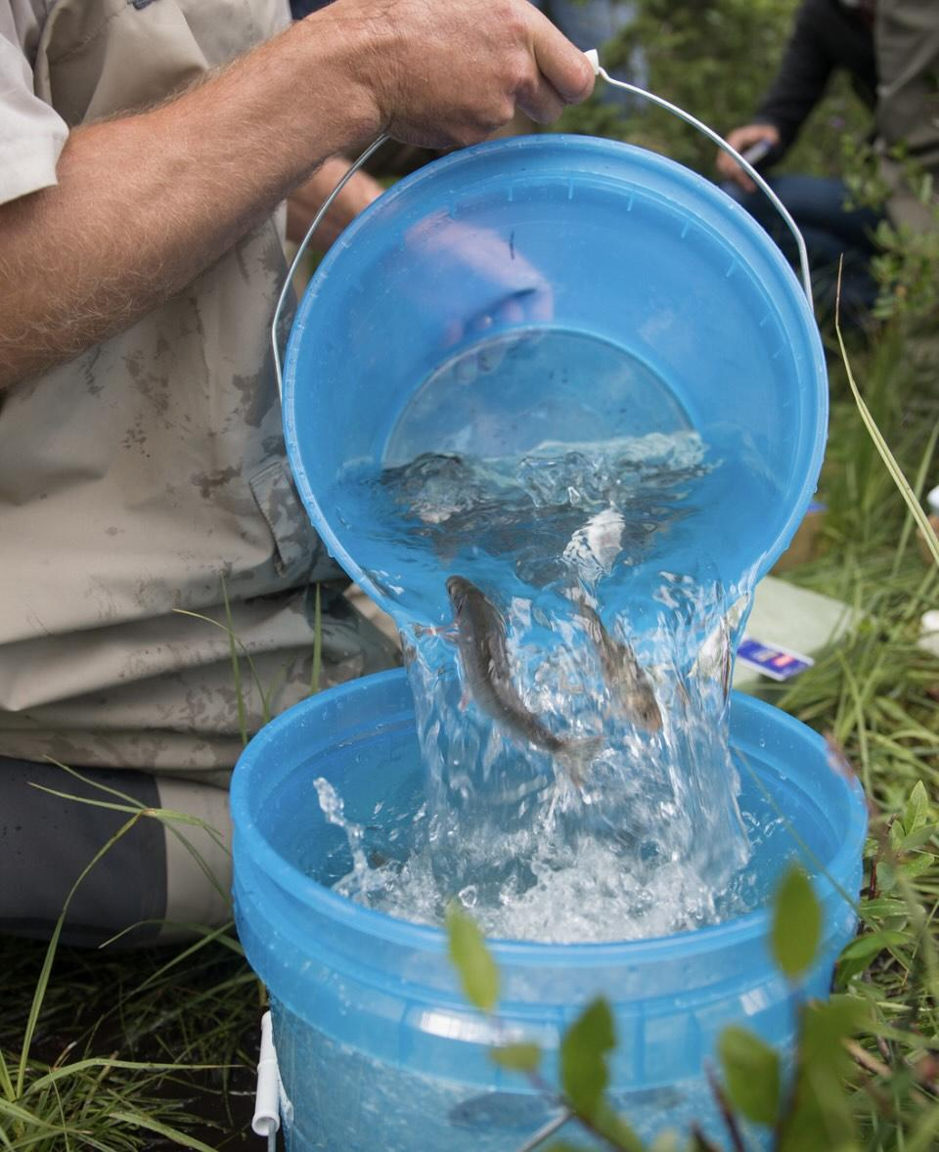
Invasive species
An invasive species is a species that is introduced to an ecosystem outside its natural range that becomes established and outcompetes native species.
Invasive species might be introduced
on purpose, like brook trout introduced into streams in the western United States for sport fishing
by accident, like the algae didymo which spread on the wet felt soles of waders of anglers travelling from one river system to another
© 2014 Josh Duplechian, Trout Unlimited

Slide 3
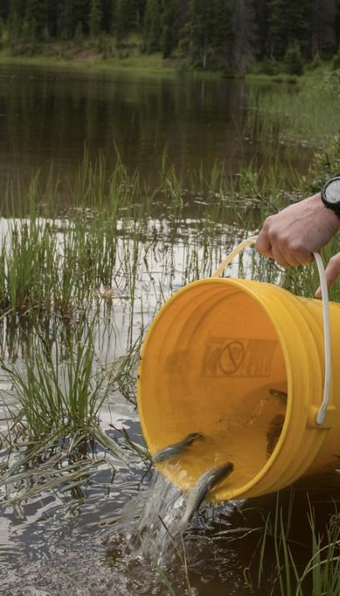
Outcompeting native species
Invasive species can outcompete native species in a new ecosystem for a number of different reasons, including:
They are free from natural predators or diseases that control their population in their original range.
They often have rapid reproduction and growth rates.
They can access new types of food sources (often because they eat a wider range of foods than native species).
They can introduce new pathogens/diseases that can harm native species.
© 2014 Josh Duplechian, Trout Unlimited

Slide 4
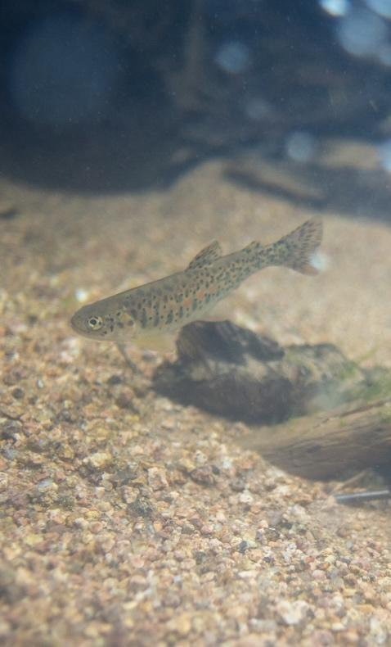
Effects on ecosystems
Invasive species can cause many harmful effects in a new ecosystem, including:
Reducing native species through competition or predation.
Can lead to loss of biodiversity.
Can alter the habitat.
If closely related to native species, invasive species can change the genetic diversity by hybridizing with native species.
This can have negative economic effects if populations of native species with economic value are reduced.
© 2014 Josh Duplechian, Trout Unlimited

Slide 5
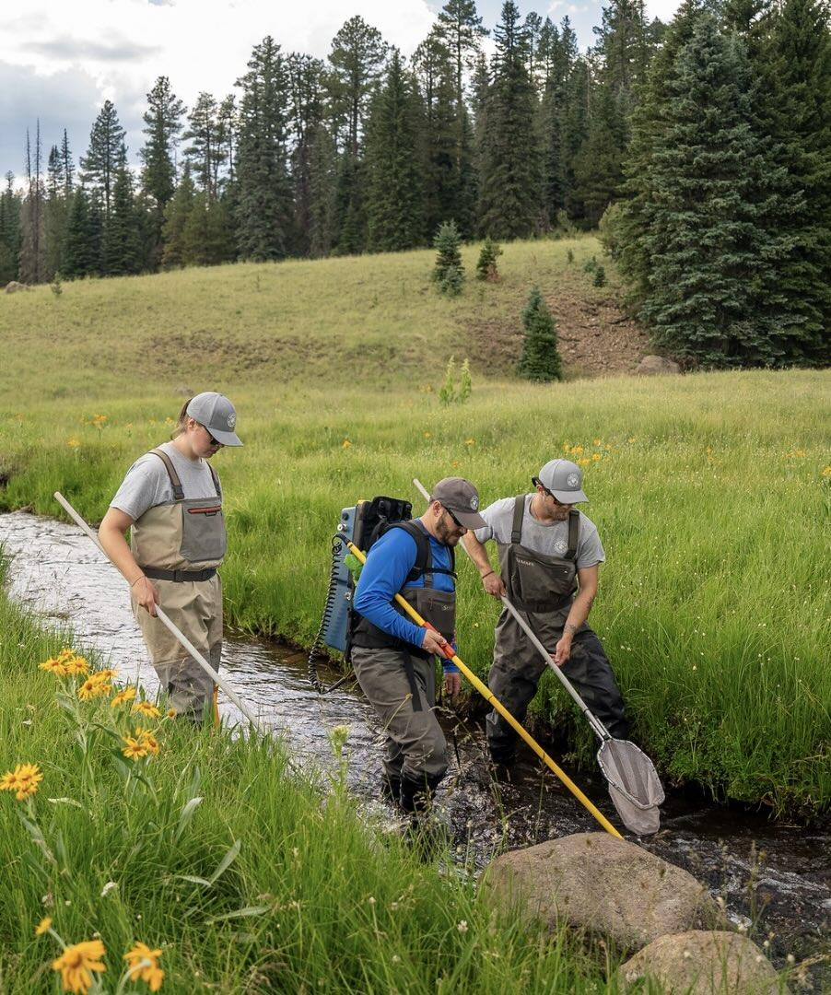
Techniques to control invasives
Some methods of control, or mitigation strategies, of invasive species include:
Direct trapping or removal
Poisoning or sterilizing with chemicals
Biological control by introducing a predator or parasite specific to the species from its native habitat
All these control methods have potential disadvantages including cost, possible ineffectiveness, and the chance of affecting other species in unforeseen ways.
© 2023 Josh Duplechian, Trout Unlimited

