Slide 1
Lesson 4.2
Invasive Species
Student Presentations

Slide 2
Presentation assignment
Choose an invasive species that is aquatic (lives in the water) and prepare a three minute/five slide presentation including:
Brief description of habitat, native and introduced range
Reasons it outcompetes native species
Negative effects on the ecosystem
Attempts to control or mitigate
At least three sources (links only)
Good website for information: USDA Aquatic Invasives page

Slide 3
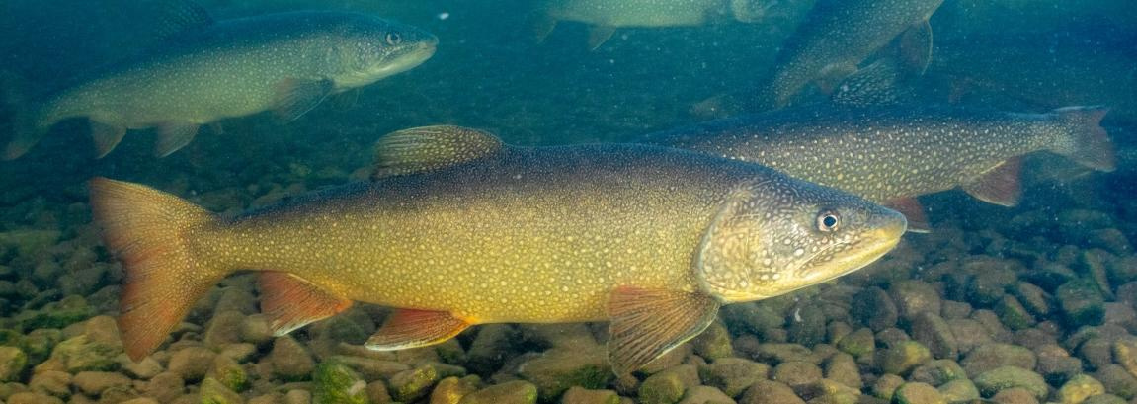
Model presentation:
Lake Trout in Yellowstone Lake
Source: Lake trout, Hagerty, Ryan/USFWS, Public Domain, https://www.fws.gov/media/lake-trout-3

Slide 4
Habitat and range of lake trout
Live in deep lakes, typically living deeper than 50 feet.
Can live in large rivers.
Native to North America from Alaska to Nova Scotia; only native to lakes east of the Rockies
Introduced in some lakes west of the Rockies, including Yellowstone Lake some time before 1994
Source: U.S. Fish and Wildlife Service, Lake Trout page

Slide 5
Lake trout outcompete native Yellowstone cutthroat trout
Larger Lake trout eat smaller Yellowstone cutthroat trout
Lake trout also eat the same food as Yellowstone cutthroat trout (leeches and aquatic insects)
Lake trout can live up to 40 years and can get over 10kg; Yellowstone cutthroat only to 7 years and 3 kg
Lake trout can produce many more times the number of eggs than Yellowstone cutthroat
Source: Yellowstone Park Trips, webpage

Slide 6
Problems caused by lake trout
Yellowstone cutthroat trout migrate into rivers, where they are food for 42 species of mammals and birds.
Lake trout do not migrate into rivers so those food webs are changed.
Yellowstone cutthroat trout were the top predator in the lake until the introduction of lake trout, so the lake food web has been changed as well.
Source: Yellowstone Park Trips, webpage

Slide 7
Attempts to control lake trout
The National Park Service has made efforts to reduce the number of lake trout in Yellowstone Lake to preserve Yellowstone cutthroat trout populations, including:
Removing over 4.5 million lake trout since 1994 with gillnets
Lake trout spawning population has been reduced by 85% since 2012
Investigating putting pellets over spawning beds to smother lake trout eggs
Complete elimination of lake trout not considered possible
Source: National Park Service, Yellowstone National Park Fish Management page

