Slide 1
Lesson 3.3
Measuring
Abiotic Requirements
for Trout
www.tu.org/headwaters © 2025 Trout Unlimited. Any use of the text or images this document contains without permission of 2025 Trout Unlimited is prohibited.

Slide 2
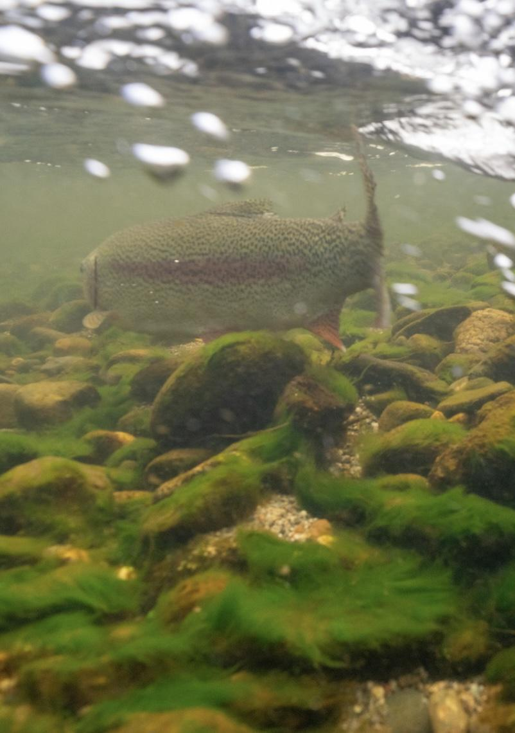
Zone of tolerance
An ecosystem is a community of living things (biotic factors) interacting with the non-living components (abiotic factors) of a specific area.
Each species has a zone of tolerance for each abiotic factor that contributes to whether a species is present and how large is the population.
For example, each species of trout has a zone of tolerance for temperature, pH and dissolved oxygen.
© 2023 Josh Duplechian, Trout Unlimited

Slide 3
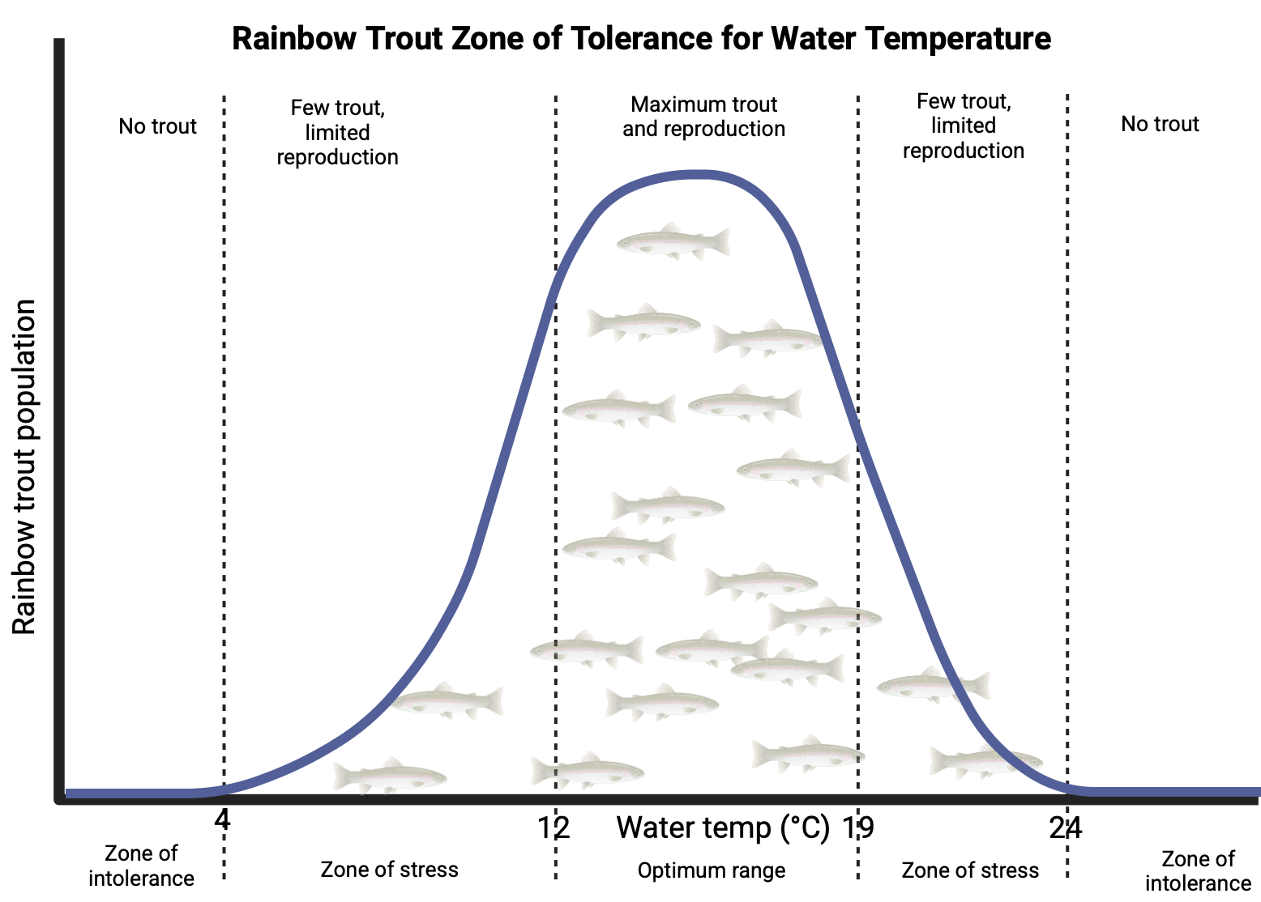
Zone of tolerance
For each abiotic factor, a species has zones of intolerance below and above extreme levels at which those organisms die or have to flee.
At less extreme higher or lower levels, the organisms are under stress and may not reproduce or grow robustly.
In the middle, there is an optimum range where there will be maximum population and reproduction.
© 2025 Trout Unlimited

Slide 4
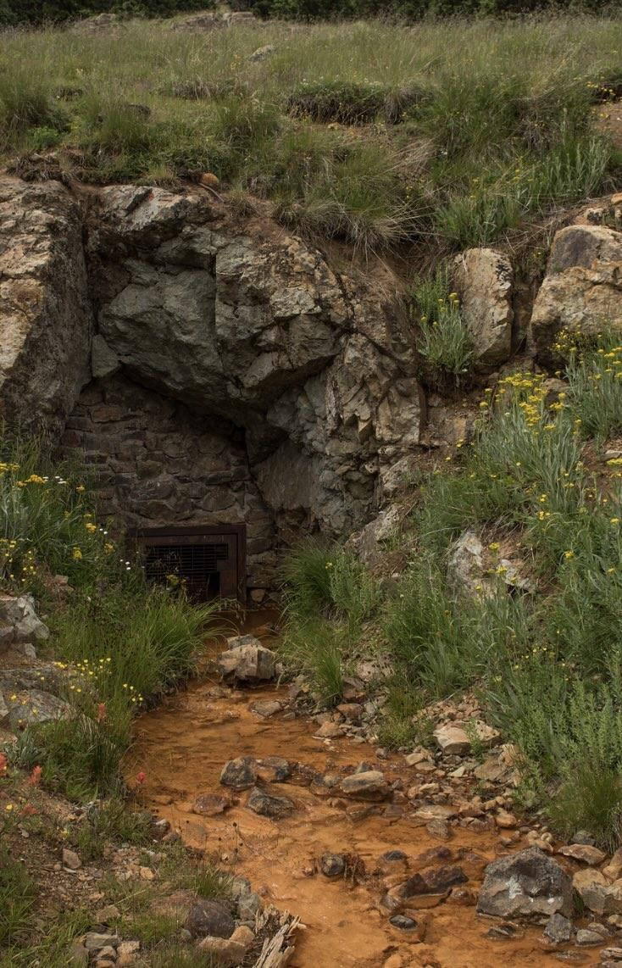
pH
Trout have a limited tolerance of water pH.
pH is measured on a logarithmic scale from 1 (very acidic) to 7 (neutral) to 14 (very basic or alkaline)
Acid mine drainage from abandoned hard rock mines often negatively affects trout populations as the water becomes too acidic (below 5.5).
Some trout streams, called limestone or chalk streams, flow through limestone bedrock which increases the pH of the water to as high as 8.0 as calcium and carbonate ions dissolve in the water.
This alkaline water contributes to robust plant and macroinvertebrate growth leading to healthy trout populations.
© 2015 Josh Duplechian, Trout Unlimited

Slide 5
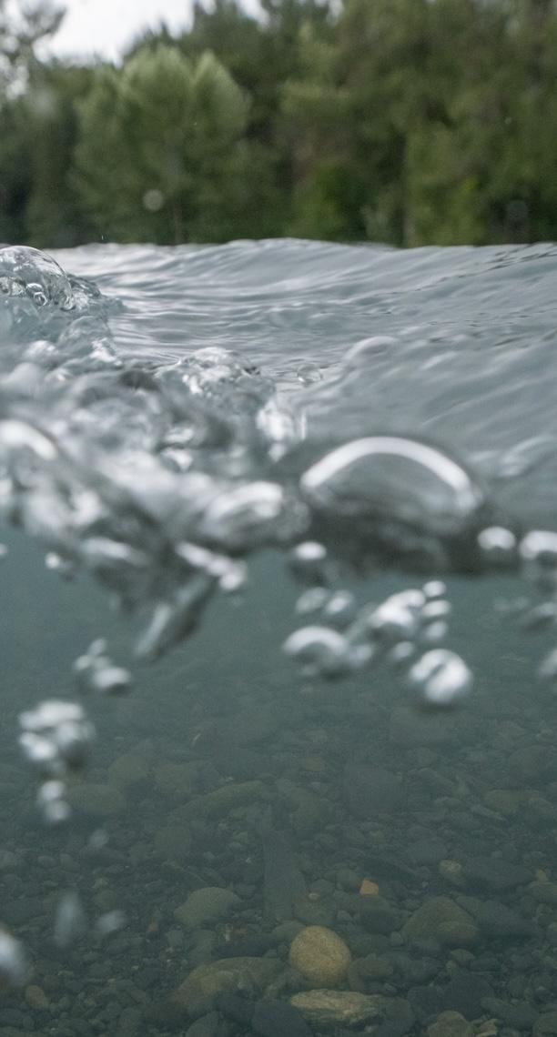
Dissolved oxygen (DO)
Another abiotic factor important to trout is dissolved oxygen (DO) which trout use their gills to oxygenate their blood.
DO enters the water from atmospheric oxygen which has a relatively higher proportion of oxygen.
DO absorption rates are increased when turbulence introduces air bubbles into the water, like at a waterfall.
DO also enters the water as a product of photosynthesis by aquatic plants.
Cold water can hold more DO than warm water.
Trout generally need DO levels of at least 5 mg/L to survive.
© 2023 Josh Duplechian, Trout Unlimited

Slide 6
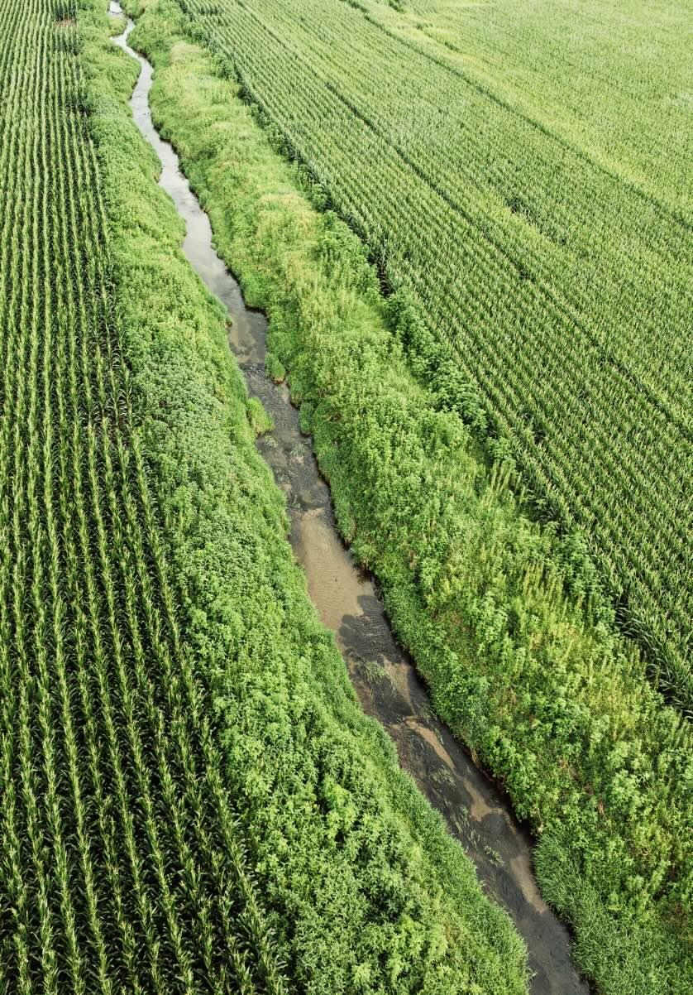
Biological oxygen demand (BOD)
Eutrophication is a type of pollution where excess nutrients cause an algal bloom which decomposes and uses up all the DO in a waterway, causing anoxic (low DO) conditions.
A measure of how much DO would be required to decompose the organic matter in a sample of water is called biological oxygen demand (BOD).
Water with high amounts of organic matter will have a high BOD which potentially could lead to low DO levels and stress on fish and other aquatic animals.
© 2024 Justin Carfagnini, Trout Unlimited

Slide 7
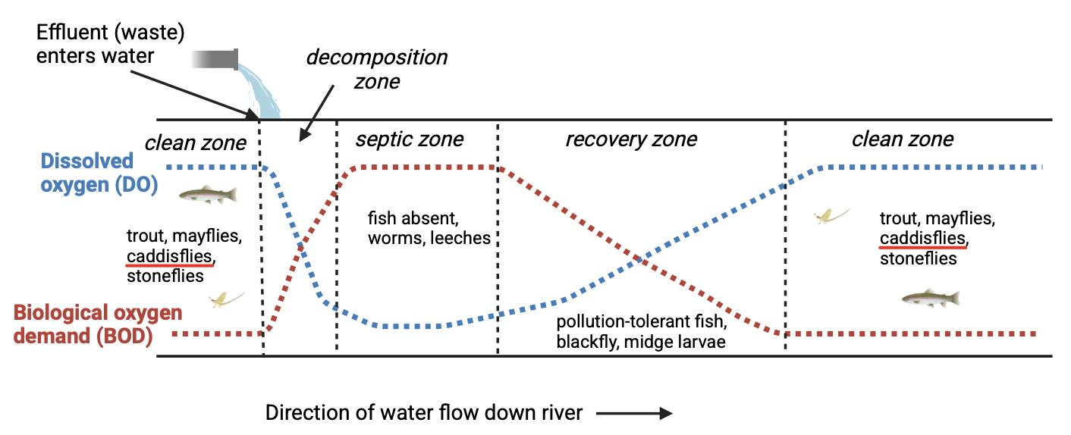
Oxygen sag curve
An oxygen sag curve is a graph showing the DO readings in a stream below a source of organic pollution.
The DO is lowest directly below the source where the BOD is highest. DO increases downstream as BOD decreases due to dilution and decomposition of the organic pollution.
Fish and macroinvertebrate sampling can show lower populations where BOD is high and DO is low, with populations rebounding downstream.
© 2025 Trout Unlimited

