Slide 1
Lesson 3.2
Trout Species
Student Presentations

Slide 2
Presentation assignment
Choose an species (or subspecies) of trout and prepare a three minute/five to eight slide presentation including:
Name (including Latin name)
Brief description of characteristics, habitat and range
Threats and conservation efforts
At least three sources (links only)
Good website for information: US Fish & Wildlife Service Species search page

Slide 3
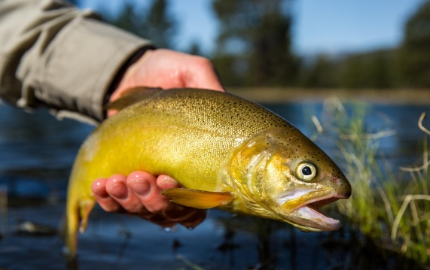
Model presentation:
Gila Trout (Onchorhynchus gilae)
Source: Gila trout, Craig Springer/USFWS, Public Domain, https://www.fws.gov/media/gila-trout-1

Slide 4
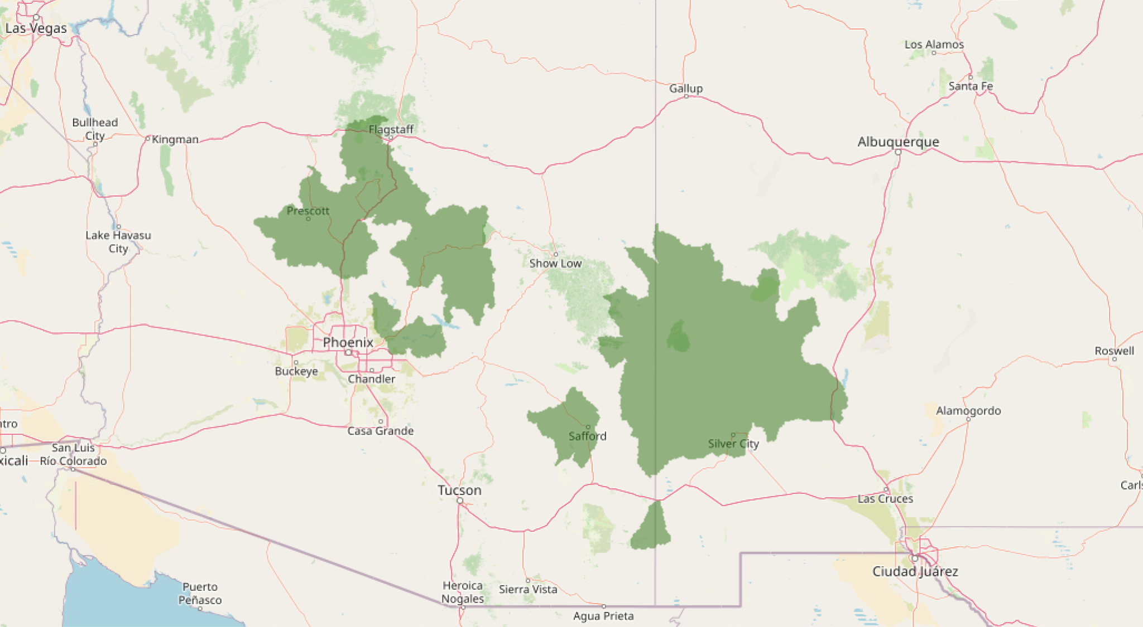
Characteristics, habitat and range
Lives in mountains of Nevada and New Mexico
Source: U.S. Fish and Wildlife Service, Gila Trout page

Slide 5
Characteristics, habitat and range
Live in small streams
Generally live to 4 to 6 years, reaching a size up to 38 cm
Can hybridize with rainbow trout
Source: New Mexico Dept. of Game & Fish, Gila Trout page

Slide 6
Threats and conservation
One of the rarest trout in North America.
Listed as endangered on the original ESA of 1973.
Threats include:
habitat loss
warming waters due to climate change
hybridization with non-native rainbow trout
wildfires
Source: U.S. Fish and Wildlife Service, Gila Trout page

Slide 7
Threats and conservation
Conservation efforts dictated by the USFWS Recovery Plan revised 2022.
Strategies include:
Protect and improve habitat
Remove non-native species (rainbow)
Reintroduce pure Gila trout in as many locations as possible
Monitor populations
Source: U.S. Fish and Wildlife Service, Gila Trout Recovery Plan

