Slide 1
Lesson 3.1
Understanding Trout Physiology
www.tu.org/headwaters © 2025 Trout Unlimited. Any use of the text or images this document contains without permission of 2025 Trout Unlimited is prohibited.

Slide 2
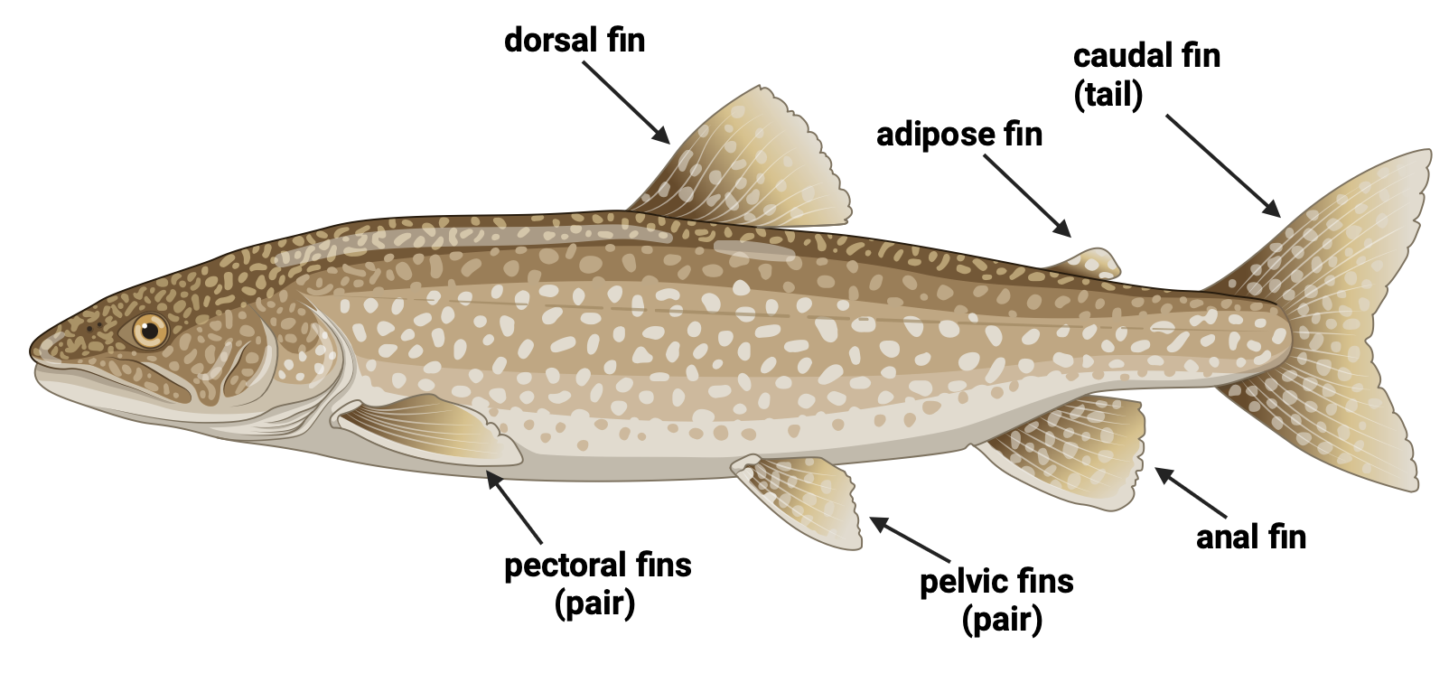
Trout fins
Trout bodies are smooth, stream-lined and torpedo-shaped to minimize drag while swimming through water.
They move forward using muscles running the length of their bodies and three single fins: dorsal, anal and caudal (tail).
© 2025, Trout Unlimited

Slide 3
Trout fins (continued)
Trout keep themselves stable in the water using two pairs of fins: pectoral and pelvic
An eighth fin (adipose) does not have a role in movement or stability.
© 2025, Trout Unlimited

Slide 4
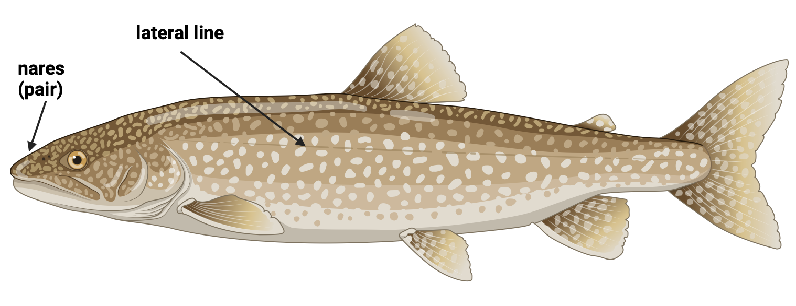
Trout sensory organs
Trout can see objects in and above the water and can see color.
Trout “smell” by detecting chemicals in the water using two openings called nares– like nostrils but do not connect to the throat.
© 2025, Trout Unlimited

Slide 5
Trout sensory organs (continued)
Like other fish, trout have a lateral line that can detect movement, pressure changes and chemicals in the water.
Sound travels well in water and trout can hear well without any external ear structures.
© 2025, Trout Unlimited

Slide 6
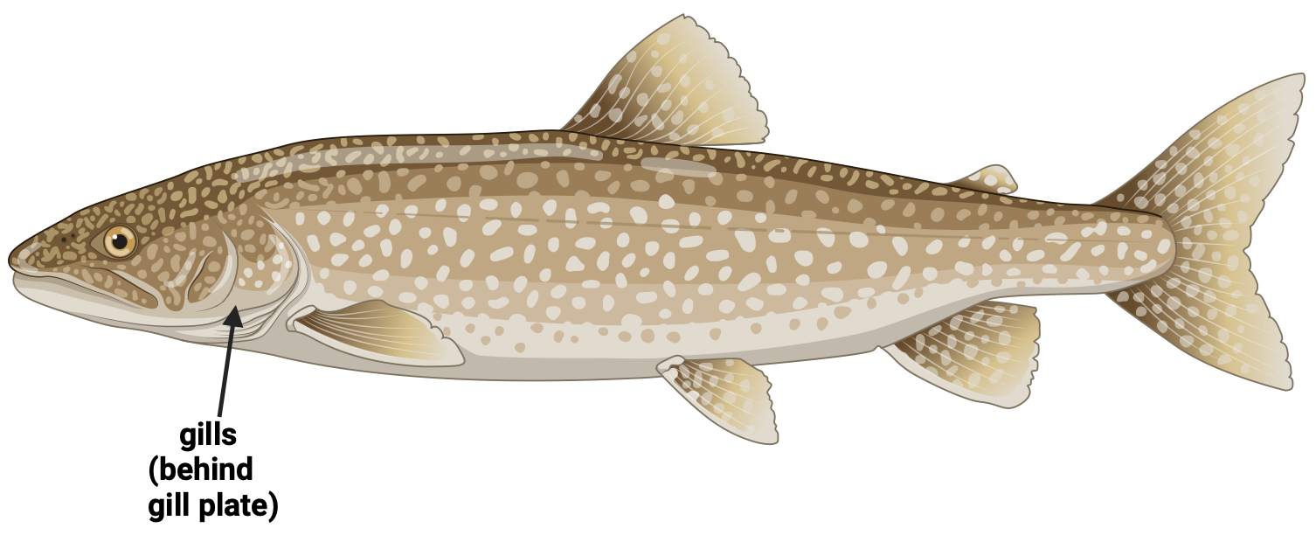
Trout internal organs
Like other aquatic animals, trout use gills which contain filaments through which blood runs, exchanging oxygen and carbon dioxide with the surrounding water passing across the gills.
Some trout use structures called gill rakes to filter out small organisms from the water to eat as whales do.
© 2025, Trout Unlimited

Slide 7
Trout internal organs (continued)
Trout have a two-chambered heart that is located behind the gills which pumps oxygenated blood to the body.
Trout have a stomach and intestine to digest their food swallowed whole before it is excreted through the anus.
Trout have a kidney, liver and spleen which serve the same purpose as in other animals: to filter waste and produce important proteins.
Trout, like other fish, have an air bladder which is a sac filled with gas that runs the entire length of the internal cavity. The air bladder is used to maintain buoyancy and stability in the water.

