Slide 1
Lesson 2.4
Hydrology Project
Student Presentations

Slide 2
Presentation assignment
Choose a Trout Unlimited stream improvement project and prepare a three minute/five slide presentation including:
Name and location of the project
Description of the issue the project addresses
Description (with picture) of the project
Links to sources of pictures and information
Good website for information: Trout Unlimited project director
© 2022 Ben Hendon, Trout Unlimited

Slide 3
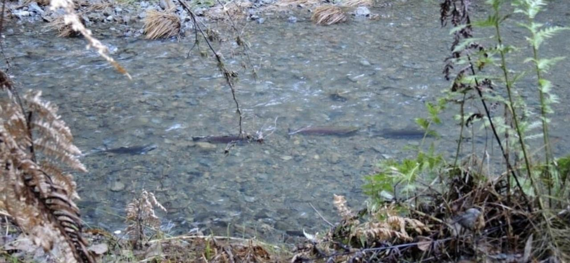
Model presentation:
Mill Creek Dam
Fish Passage Project
Source: Mary Ann King, https://www.tu.org/magazine/uncategorized/11-2-miles/

Slide 4
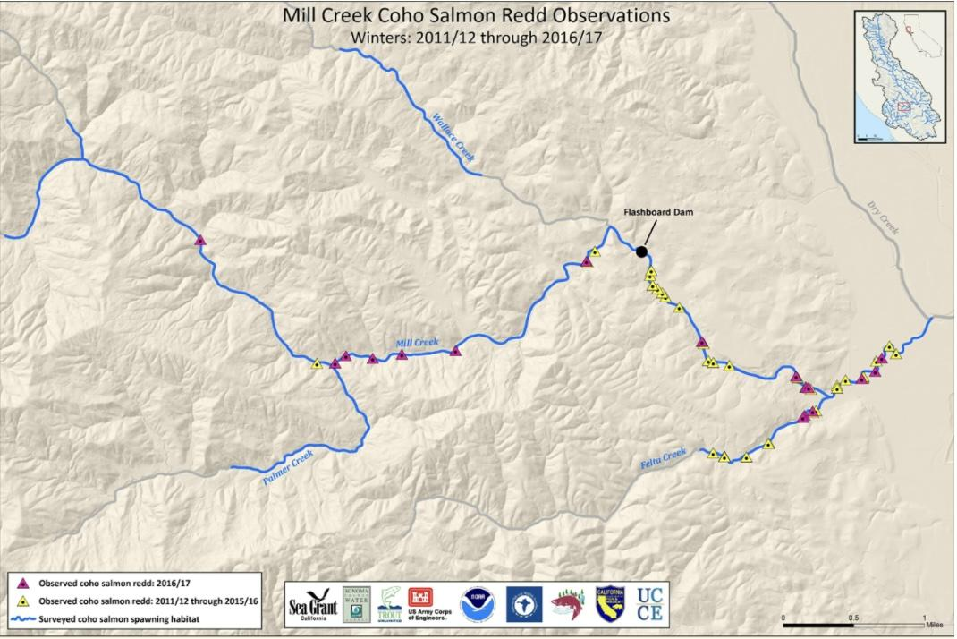
Mill Creek location
Northern California, tributary to the Russian River in Sonoma County, north of San Francisco
Source: California Sea Grant, https://www.tu.org/magazine/uncategorized/11-2-miles/

Slide 5
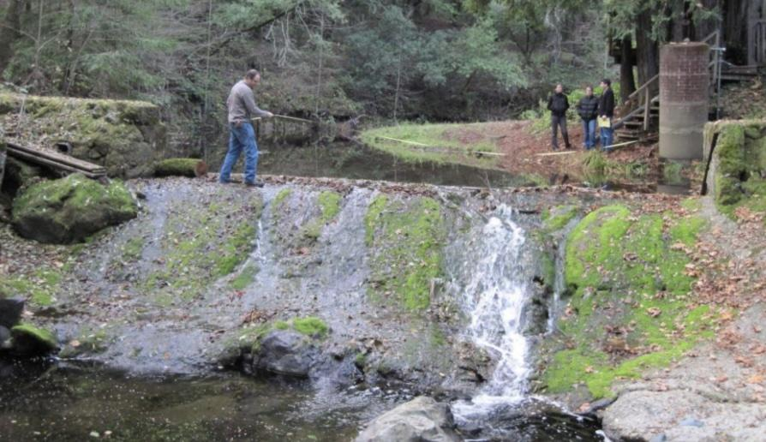
Issue addressed by project
A dam on Mill Creek was a barrier to fish passage.
Coho salmon were blocked from 11.2 miles of their traditional spawning habitat.
Mill Creek is critical habitat for endangered California coho salmon as it stays flowing even during drought conditions.
Dam before project
Source: Stephen Nett, Santa Rosa Press Democrat

Slide 6
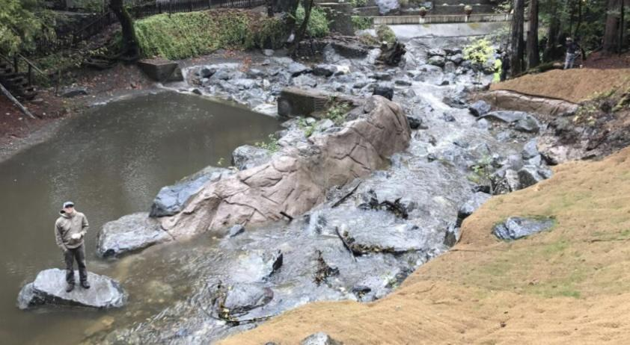
Project description
The old dam was partially removed in 2016, creating a ramp and a side channel for fish to use for passage.
The year after the project was completed, eight Coho salmon redds were observed upstream of the dam site.
Dam after project
Source: Stephen Nett, Santa Rosa Press Democrat

