Slide 1
Lesson 2.4
Assessing Human Impacts
on Hydrology
www.tu.org/headwaters © 2025 Trout Unlimited. Any use of the text or images this document contains without permission of 2025 Trout Unlimited is prohibited.

Slide 2
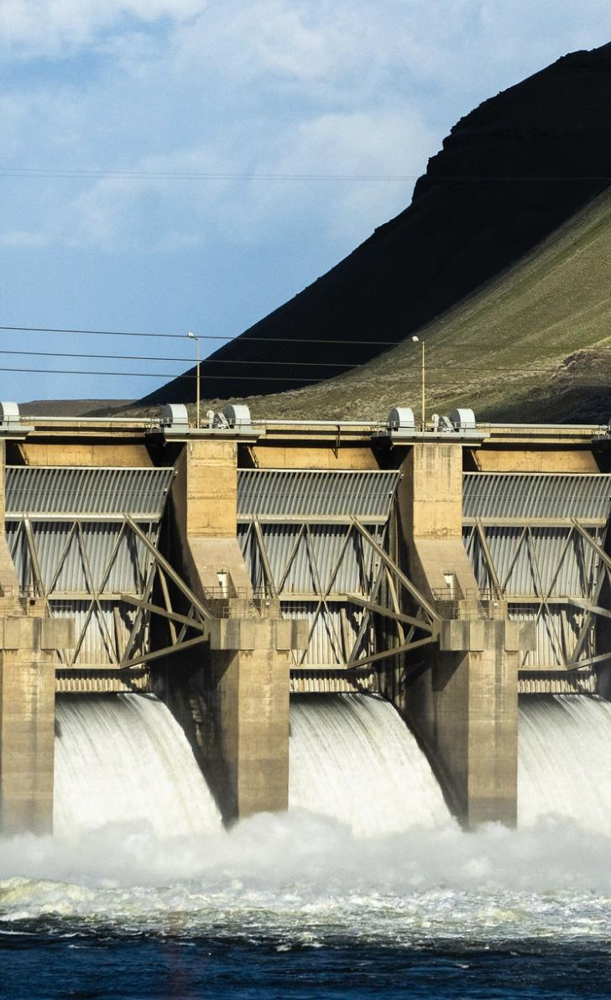
Benefits of dams
Humans build dams across rivers to form reservoirs for many reasons, including:
water storage for drinking and irrigation water
hydroelectric power (carbon-free after dam construction)
flood control
recreation (boating and fishing in the reservoir)
prior to the development of engines, to use the water to drive mill wheels and other machinery
© 2022 Ben Hendon, Trout Unlimited

Slide 3
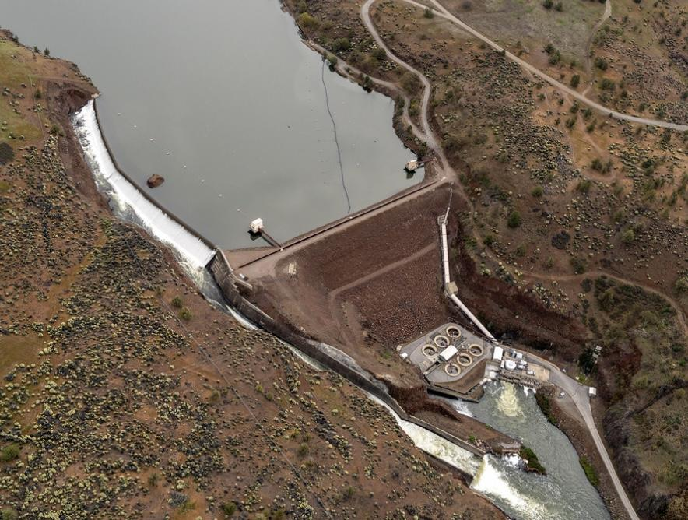
Environmental harms of dams
Dams have significant negative effects on river ecosystems, including:
preventing fish from migrating up and down rivers
changing a flowing river habitat into a still lake habitat in the reservoir
changing the natural flow patterns of a river
preventing most sediment from being carried downstream (it is trapped behind the dam instead)
increasing water temperatures and evaporation in the still water of the reservoir (depending on the climate and depth of the reservoir)
© 2023 Joshua Duplechian, Trout Unlimited

Slide 4
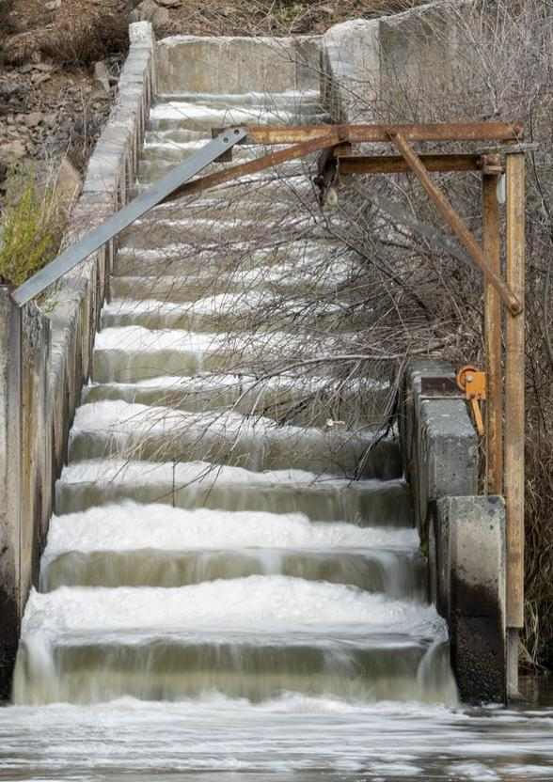
Dams as a barrier to fish passage
As migratory species, trout and salmon are particularly affected by dams as a barrier to fish passage.
Some dam operators try to mitigate this by installing a fish ladder, which is a series of steps serving as an artificial waterfall that migrating fish can use to get past the dam.
Other efforts include capturing the fish below the dam and transporting them up over the dam.
© 2023 Joshua Duplechian, Trout Unlimited

Slide 5
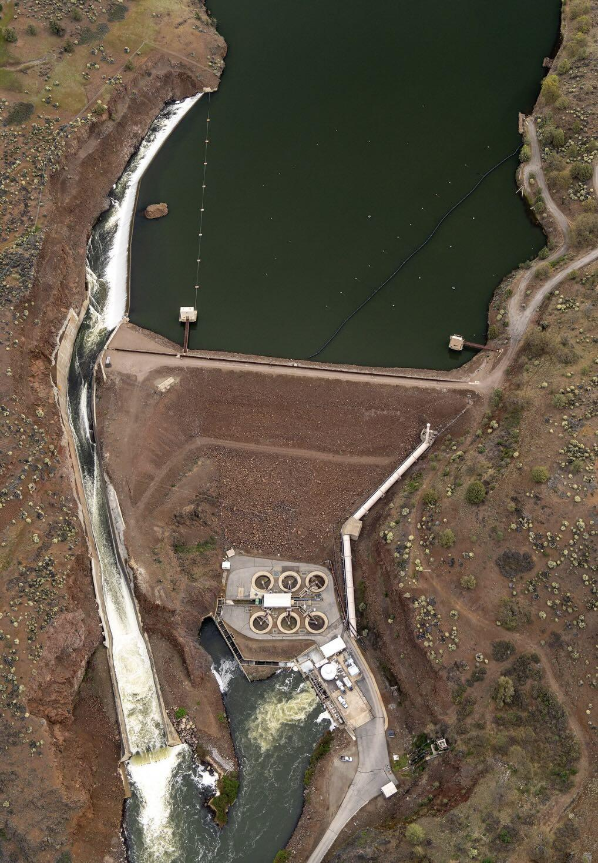
Dams as a barrier to fish passage
Fish ladders and transport are not completely effective as some fish are stopped by the dam anyway.
The presence of a large stretch of still water in the reservoir confuses:
adult fish on the way upstream
juvenile smolts on the way down who are adapted to be carried down by the current
The most effective way to mitigate the harms of dams is removal, particularly if they do not serve their original purpose.
© 2023 Joshua Duplechian, Trout Unlimited

Slide 6
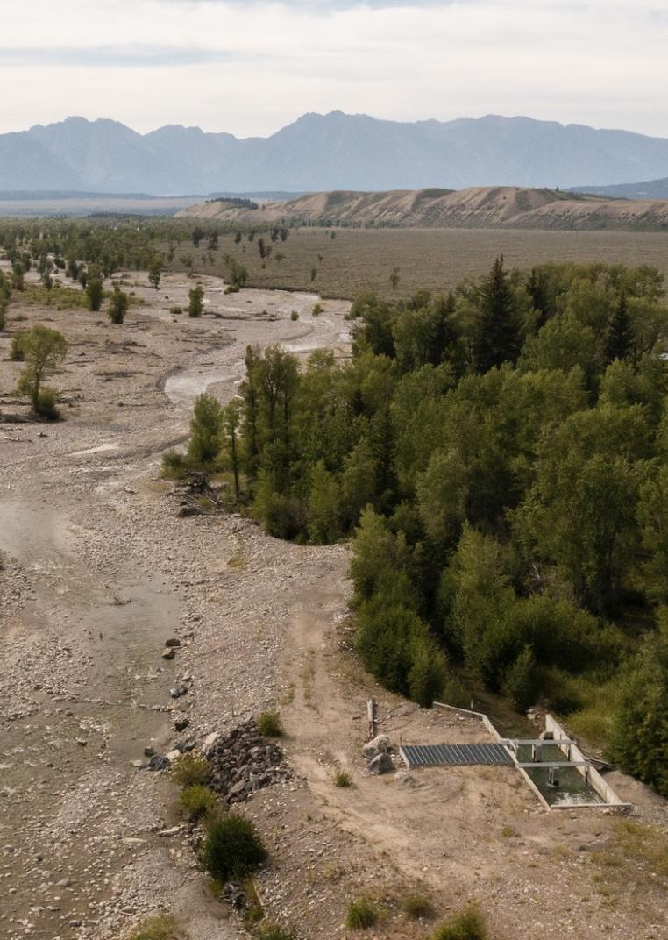
Water diversions
Humans take water out of rivers, a practice called water diversions, for use as:
drinking water
even more significantly, irrigation
This is particularly harmful as irrigation is most needed during the dry conditions when water is most needed in the river.
Trout can get stranded and die in irrigation channels.
© 2021 Trout Unlimited

Slide 7
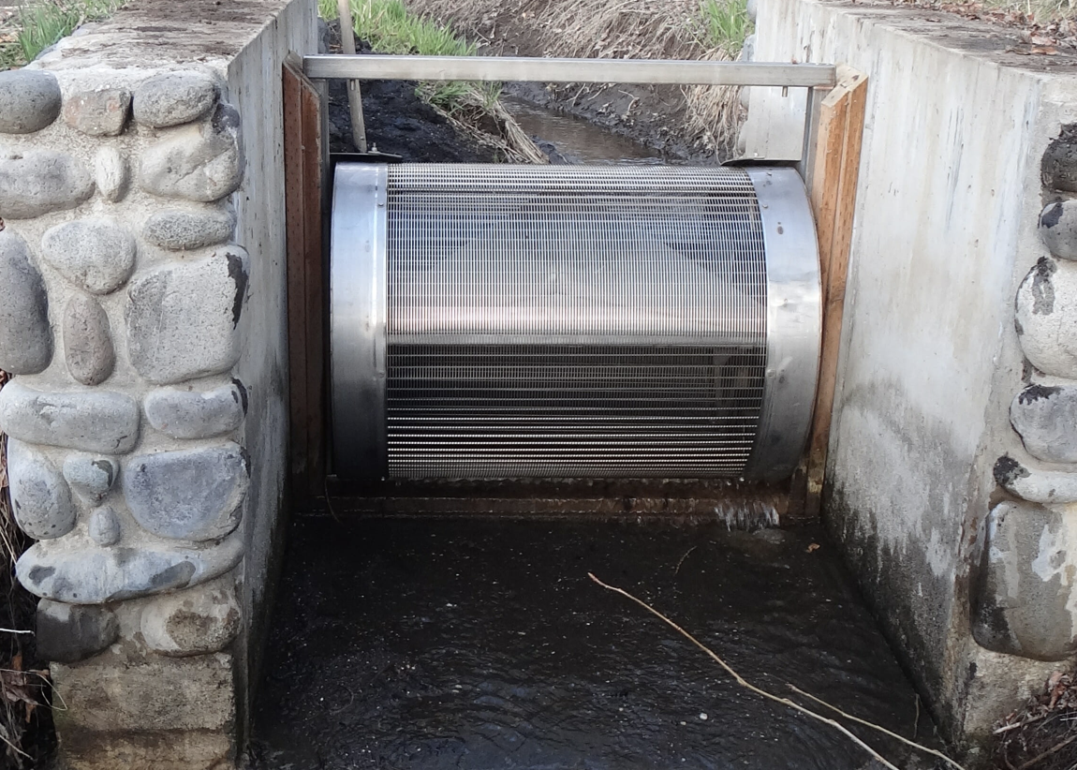
Water diversions
The harms of water diversions can be reduced by:
improving the channels, like installing screens to keep fish out
reducing the amount of water used for domestic or irrigation use
© 2025 Trout Unlimited

Slide 8
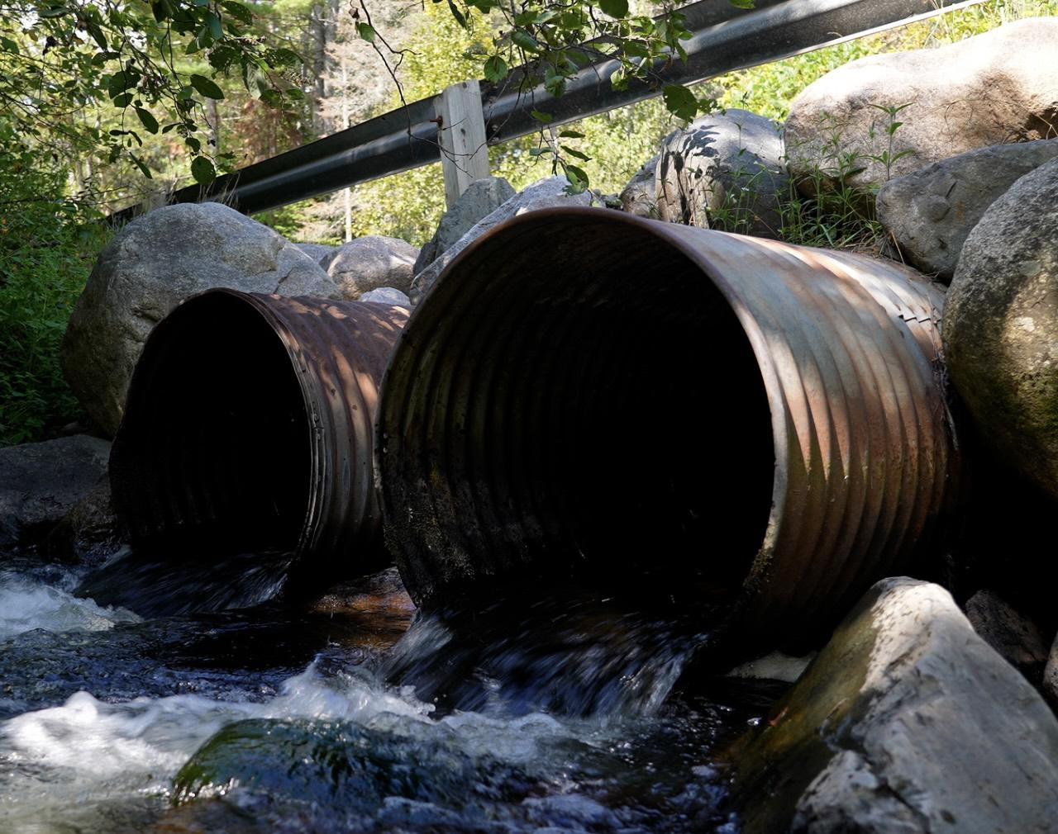
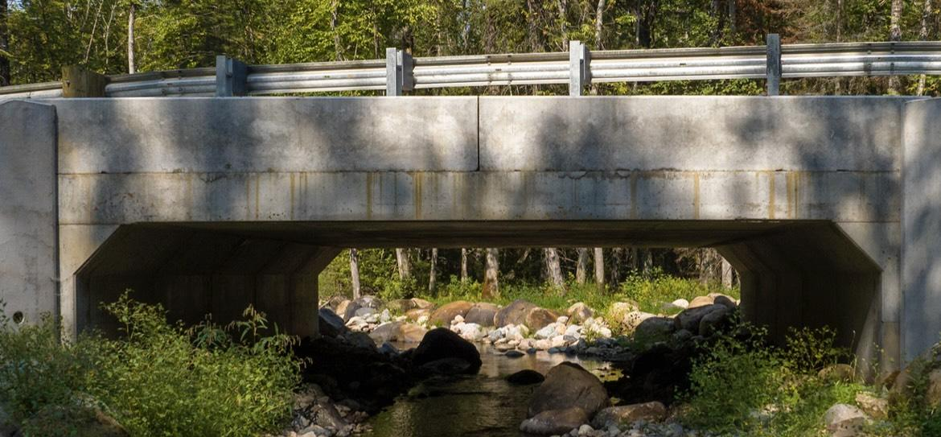
Culverts
When building roads across small streams in particular, engineers sometimes direct the water through a culvert.
If the end of the culvert is suspended above the stream, making an artificial waterfall, it is called a perched culvert and can be a barrier to fish passage.
This is mitigated by replacing the culvert with a bridge, allowing the stream to flow naturally across the ground.
© 2023 Trout Unlimited

Slide 9
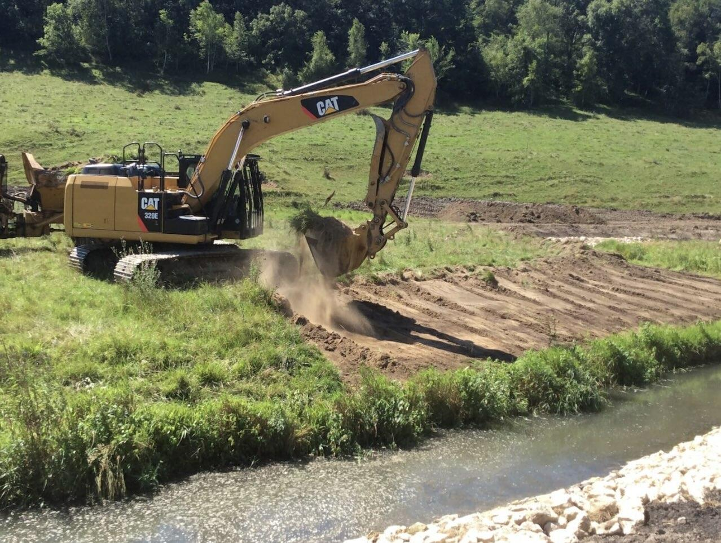
Channelization
Channelization is when humans straighten the course of a stream and reinforce its banks to keep it in place and protect buildings and property.
This is particularly common when a stream runs through an urban or suburban area which:
prevents the natural meandering pattern of rivers
reduces the diversity of habitat available to fish and other aquatic species
often increases water temperatures because the river is shallow and unshaded
© 2025 Trout Unlimited

