Slide 1
Lesson 2.3
Measuring Sediment Transport
www.tu.org/headwaters © 2025 Trout Unlimited. Any use of the text or images this document contains without permission of 2025 Trout Unlimited is prohibited.

Slide 2
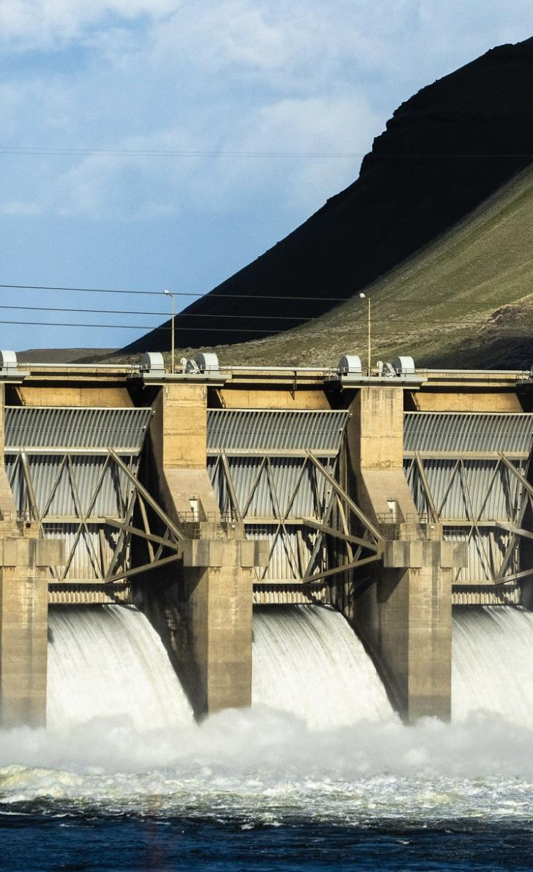
Weathering
Weathering is when rocks are broken down into sediments (smaller rock pieces) by either:
physical processes like abrasion
chemical processes like acid rain
© 2022 Ben Hendon, Trout Unlimited

Slide 3
Sediment size classification
Sediments can be classified according to their average grain size (diameter of pieces) according to the categories to the table at right
Grain size is important because it determines which agent of erosion can move the sediment and what velocity of water is required.
Boulders | > 258 mm | > about 10 inches
Cobbles | 64 - 258 mm | about 2.5 - 10 inches
Pebbles | 2 - 64 mm | about a tenth to 2.5 inches
Sand | 0.0625 - 2 mm
Silt | 0.004 - 0.0625 mm | too small to see with the human eye
Clay | < 0.004 mm | too small to see with the human eye

Slide 4
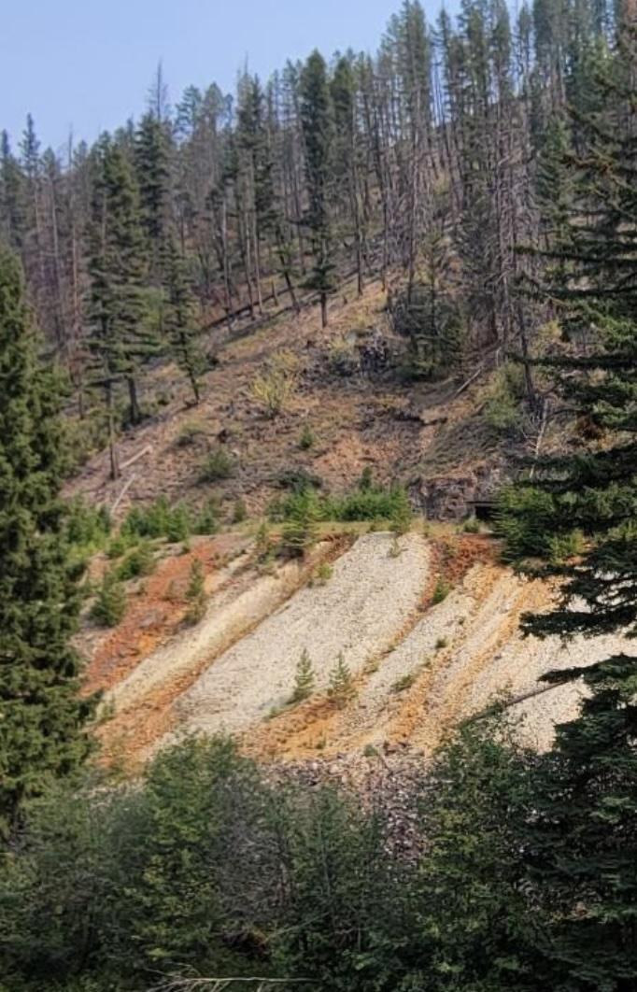
Erosion
Erosion is when sediments are moved by agents such as water, wind, ice or gravity from one place to another.
The faster the water flows, the heavier the sediments it can carry.
Erosion can be:
fast and dramatic (like landslides that occur in a matter of seconds)
slow and dramatic (like the formation of the Grand Canyon over millions of years)
or slow and not-so-dramatic (like the wearing away of the Appalachian Mountains).
© 2024 Trout Unlimited

Slide 5
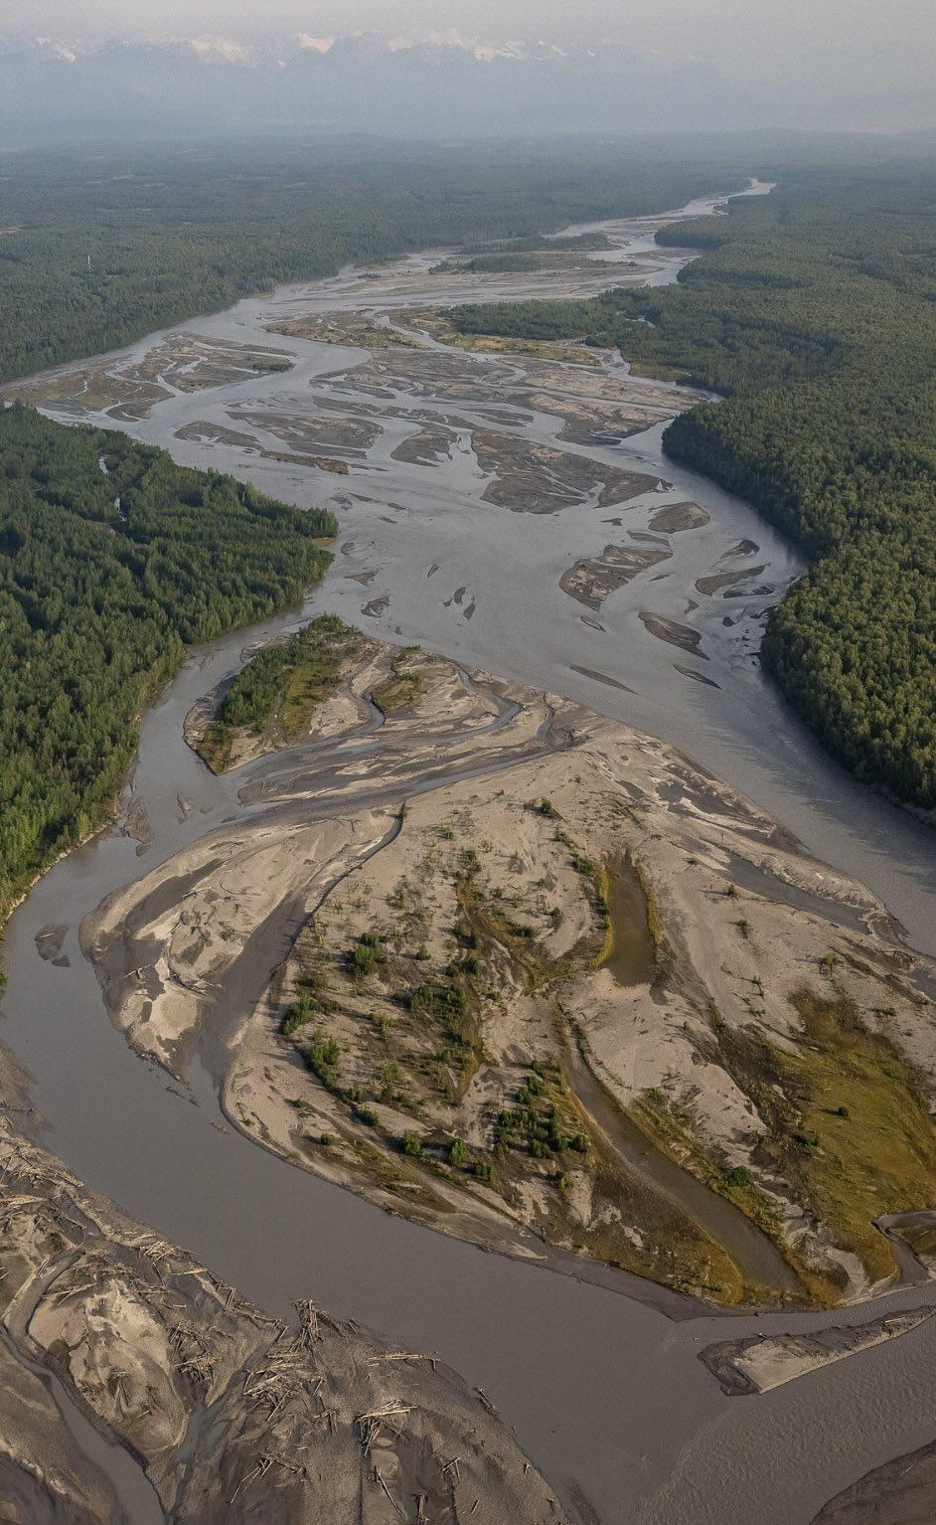
Deposition
Deposition is the build-up of sediments caused when the forces of erosion are no longer strong enough to carry their sediment load.
Common depositional environments occur where flowing water slows down rapidly upon entering a body of still or much slower moving water such as the side of a big pool in a stream, marsh, lake, estuary or the ocean.
© 2023 Josh Duplechian, Trout Unlimited

Slide 6
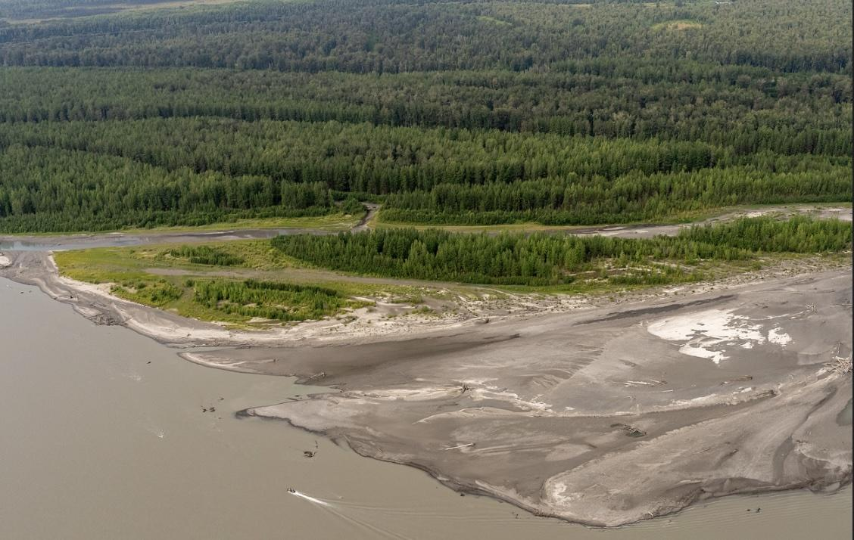
Deltas
Although large amounts of sediments can be deposited rapidly (like landslide debris and flood deposits), most stream sediments are deposited slowly and steadily in specific areas, such as a delta.
Deltas are areas of deposition (often roughly triangular in shape) located near the mouths of rivers.
Because of their importance for trade, many deltas, such as those formed by the Mississippi (New Orleans, Louisiana) and Nile Rivers (Alexandria, Egypt), have been developed into urban areas.
© 2023 Josh Duplechian, Trout Unlimited

Slide 7
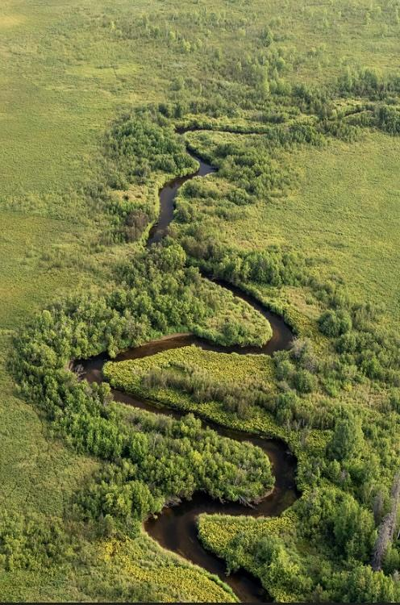
Deposition in rivers
Deposition of stream sediments also occurs in and around river beds.
Within a river bed there are areas of faster and slower moving water, often associated with a bend or change in slope or width of the river bed.
Erosion tends to occur along those parts of the river bed where the water moves the fastest while deposition occurs along those parts of the river bed where the water moves the slowest.
Deposition also occurs on the relatively flat areas called flood plains located on either side of many rivers. This is where rivers begin to meander, or curve.
© 2023 Josh Duplechian, Trout Unlimited

