Slide 1
Lesson 2.2
Measuring Stream Discharge
www.tu.org/headwaters © 2025 Trout Unlimited. Any use of the text or images this document contains without permission of 2025 Trout Unlimited is prohibited.

Slide 2
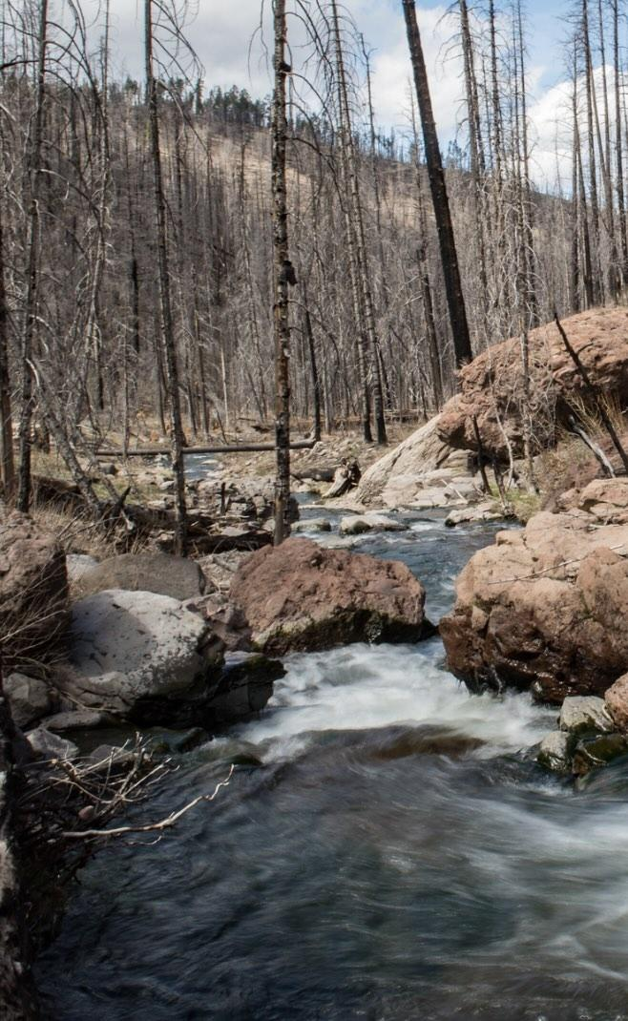
Stream discharge
Stream discharge is the measure of the volume of water that is flowing in a stream or river at any given time. It can be calculated by measuring the width and depth of the stream along with the velocity of the water.
Discharge of a stream can be affected by many factors, including:
Size of the watershed that is drained into the stream
Amount of precipitation that has fallen in the watershed
© 2017 Josh Duplechian, Trout Unlimited

Slide 3
Stream discharge (continued)
Discharge varies along the length of a stream due to a number of factors, including:
Steepness of the stream
Amount of water that is lost to infiltration into the ground
Amount of water that is lost to evaporation
Amount of water coming in via tributaries
Type of material on the bottom of the stream
© 2017 Josh Duplechian, Trout Unlimited

Slide 4
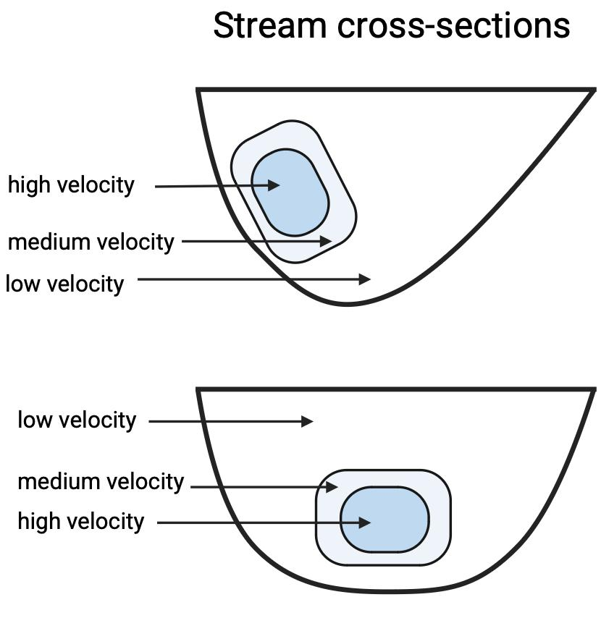
Velocity
Velocity is a measure of the distance travelled over time.
Its metric units will be meters/seconds.
Water in different parts of the stream will have different velocities depending on
Depth
Type of bottom
Straightness of stream

Slide 5
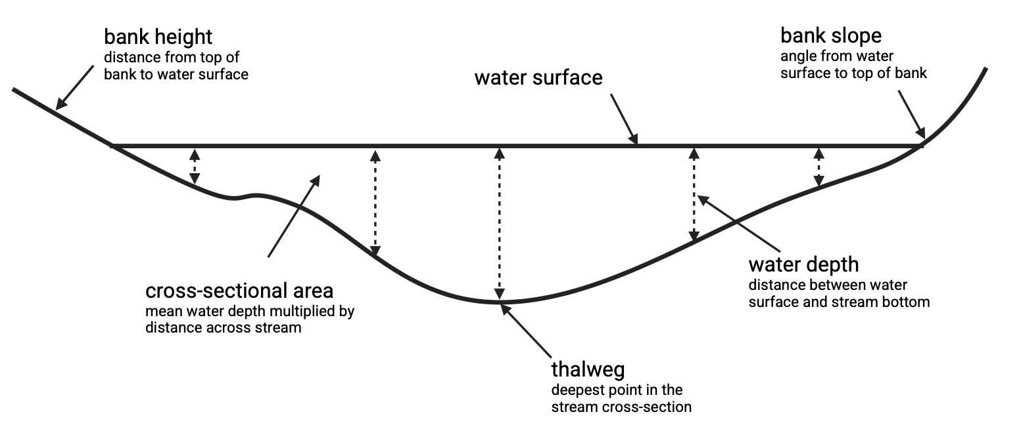
Cross-sectional area
The area of a horizontal cross section of a stream.
Thalweg is the deepest point of a cross-section and will often have the greatest water velocity leading the greatest amount of erosion and sediment transport.

Slide 6
Stream discharge
Stream discharge at a point can be calculated by multiplying the cross-sectional area (width x depth) with the velocity.
Discharge is denoted by the variable Q using the formula
Q = w * d * v
where w = width, d = depth and v = velocity
The metric units will be meters cubed/seconds (m³/sec). In the U.S. it is often measured in cubic feet per second (cfs).

