Slide 1
Lesson 1.3
Measuring Biodiversity
www.tu.org/headwaters © 2025 Trout Unlimited. Any use of the text or images this document contains without permission of 2025 Trout Unlimited is prohibited.

Slide 2
Biodiversity
Biodiversity is the richness of species living in an ecosystem.
It includes the range (variety) of species and the abundance (number) of species.
Ecosystems that are more biodiverse are more likely to recover from disruptions because there are more relationships between species (for example, if a predator species has many different prey species to eat there are other options if one prey species decreases).
© 2023 Josh Duplechian, Trout Unlimited

Slide 3
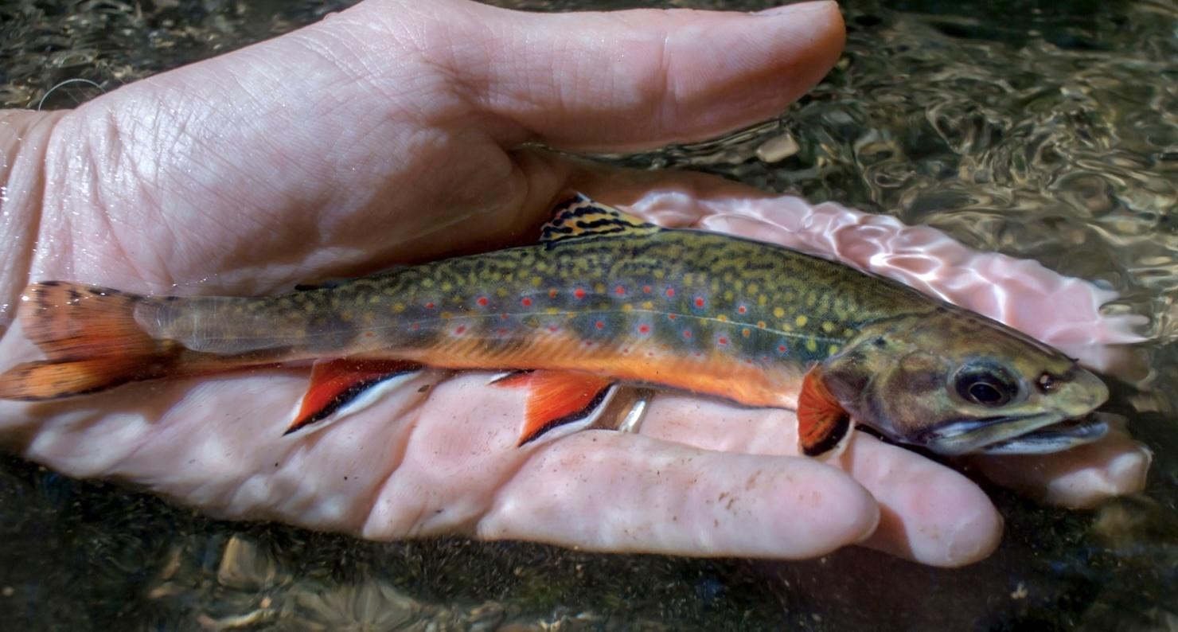
Indicator species
An indicator species is one that can be used to assess a specific environmental condition diversity of species living in an ecosystem
The presence or absence of an indicator species can indicate something about an ecosystem.
For example, if a certain species is very sensitive to pollution, its presence in an ecosystem means the ecosystem is not polluted.
© 2014 Trout Unlimited

Slide 4
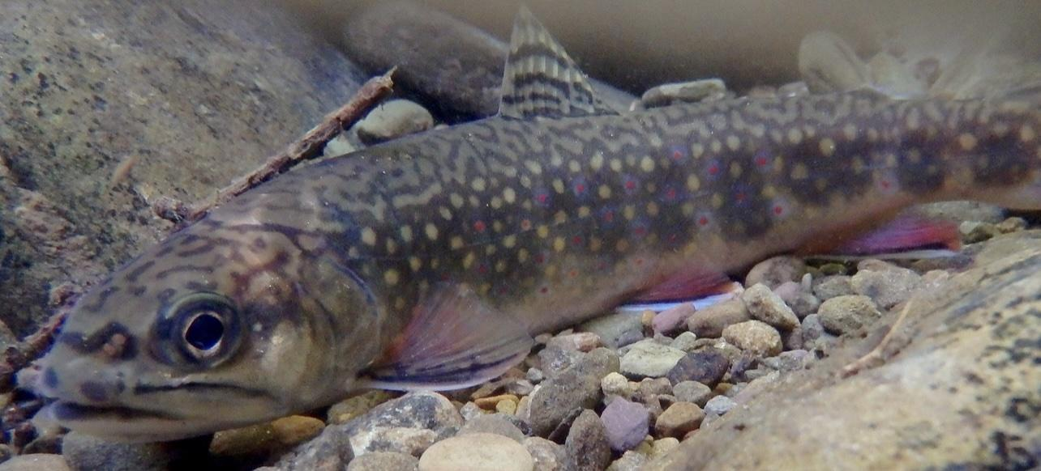
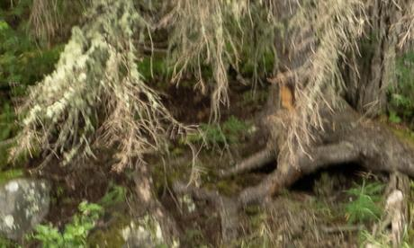
Indicator species
This is often easier than direct measurement of the ecosystem itself.
Examples:
Trout need cold, clean water so the presence of trout indicates a healthy stream
Lichen is sensitive to air pollution so its presence indicates clean air
© 2019 Trout Unlimited
© 2023 Josh Duplechian, Trout Unlimited

Slide 5
Biotic index
A biotic index is a technique of assessing and quantifying the health of an ecosystem.
Steps:
Collect a sample of organisms from an ecosystem
Identify and list the species found
Assign each species a value based on its pollution-tolerance
Calculate a summary score based on those values which can be used as a relative measure quantifying the health of the ecosystem

Slide 6
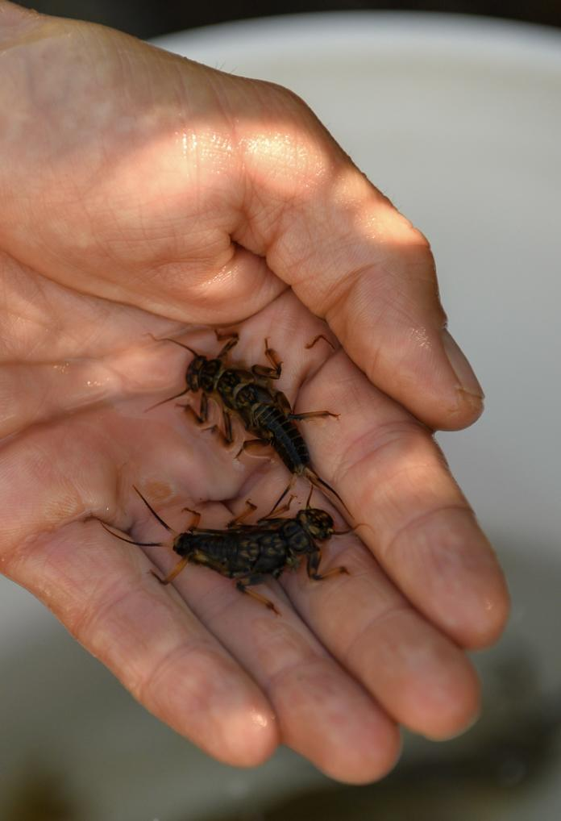
Sampling a stream
Macroinvertebrate is a general term for large (can be see with the naked eye) organisms without a backbone like insects, worms and shellfish that are found in a stream
Generally live at the bottom of a stream and can be sampled with a kicknet.
The macroinvertebrates are identified, with certain species being pollution-tolerant and others are pollution-intolerant.
The relative abundance of each types of macroinvertebrate can be used to calculate a biotic index for the stream.
© 2020 Josh Duplechian, Trout Unlimited

Slide 7
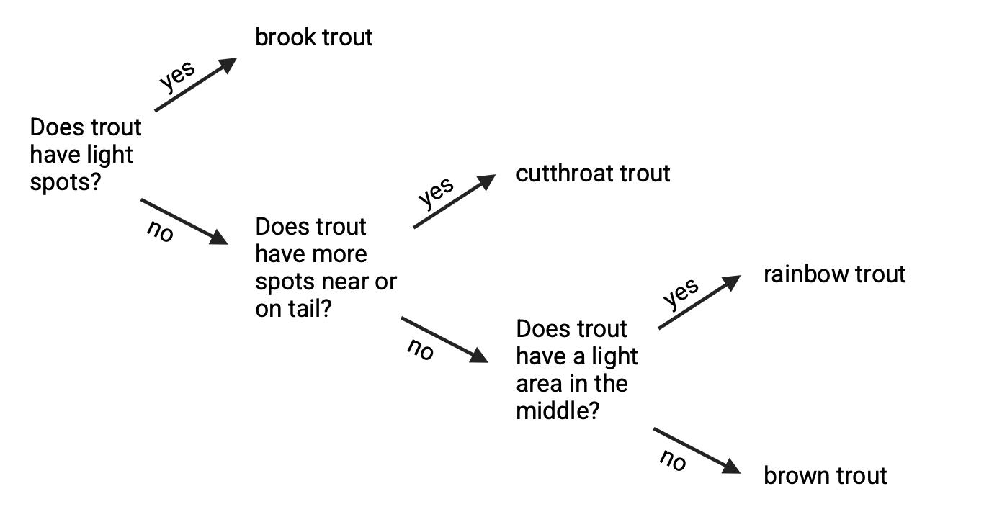
Dichotomous key
A dichotomous key is a chart with a series of yes/no questions that allows you to narrow down the identification of a species.

