Slide 1
Lesson 1.2
Understanding Energy Flow
www.tu.org/headwaters
© 2025 Trout Unlimited. Any use of the text or images this document contains without permission of 2025 Trout Unlimited is prohibited.

Slide 2
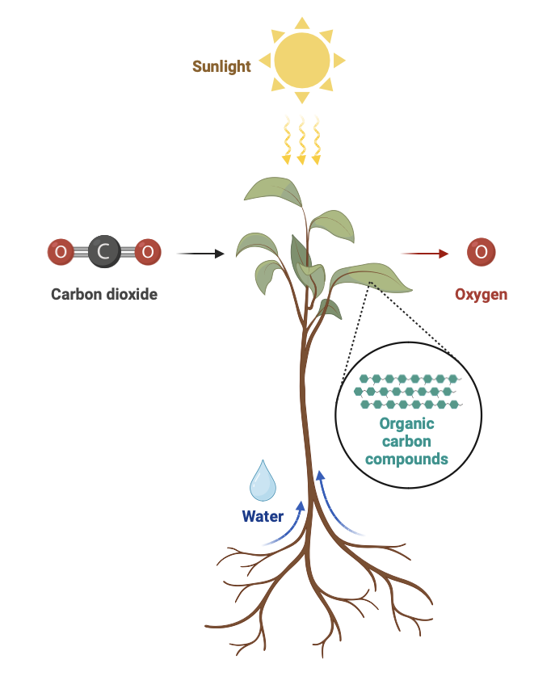
Energy flow starts with the sun
Most ecosystems rely on a supply of energy from the sun.
Light energy is converted into chemical energy in organic carbon compounds (such as glucose) through a chain of chemical reactions called photosynthesis.
Organisms (such as plants) who synthesize their own organic compounds are called autotrophs or producers.

Slide 3
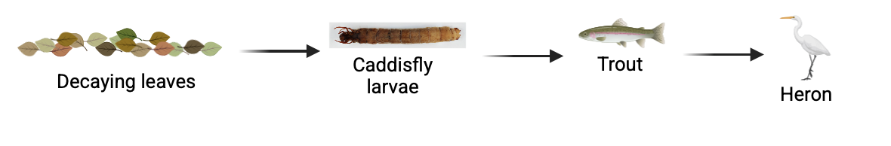
Energy transfers
Organisms that get their organic compounds through feeding are called heterotrophs or consumers.
Food chains describe a sequence of organisms feeding on each other.

Slide 4
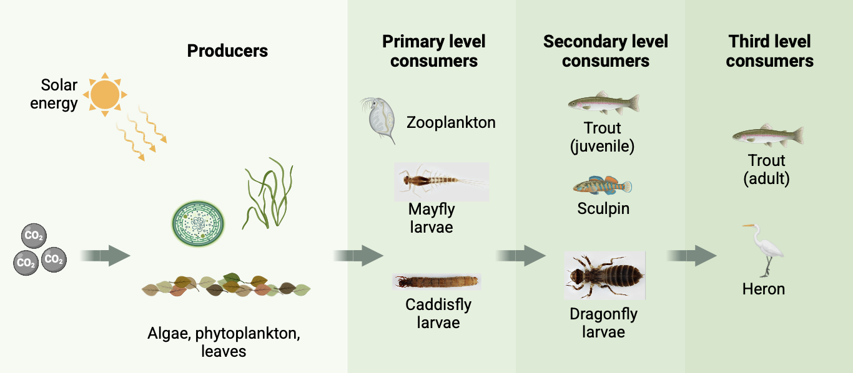
Energy transfers
Each step in the sequence can be described as a trophic level, or role that an organism plays in a food chain, starting with producer, then primary consumer, secondary consumer and so on.

Slide 5
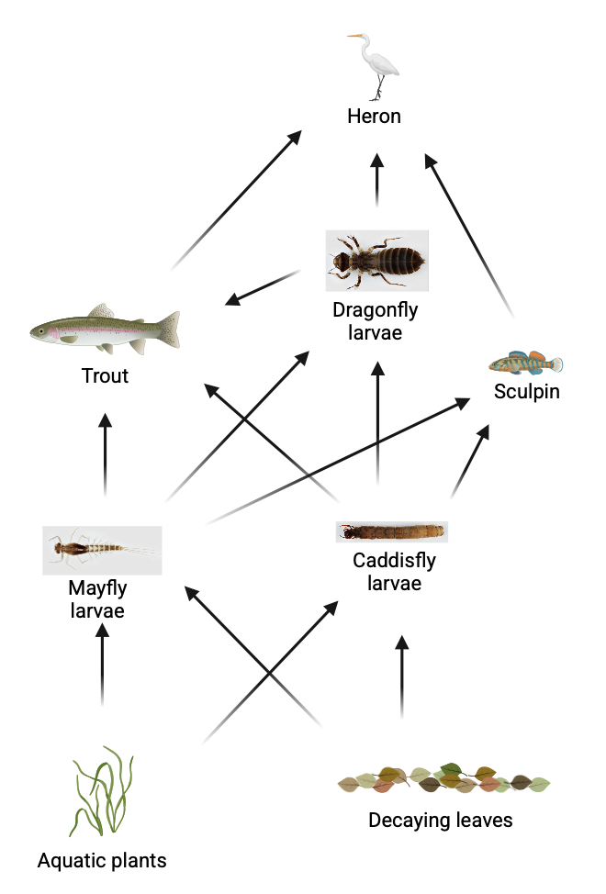
Food webs
A food web is a summary of all possible food chains in an ecosystem. The same organism can occupy different trophic levels in different food chains.

Slide 6
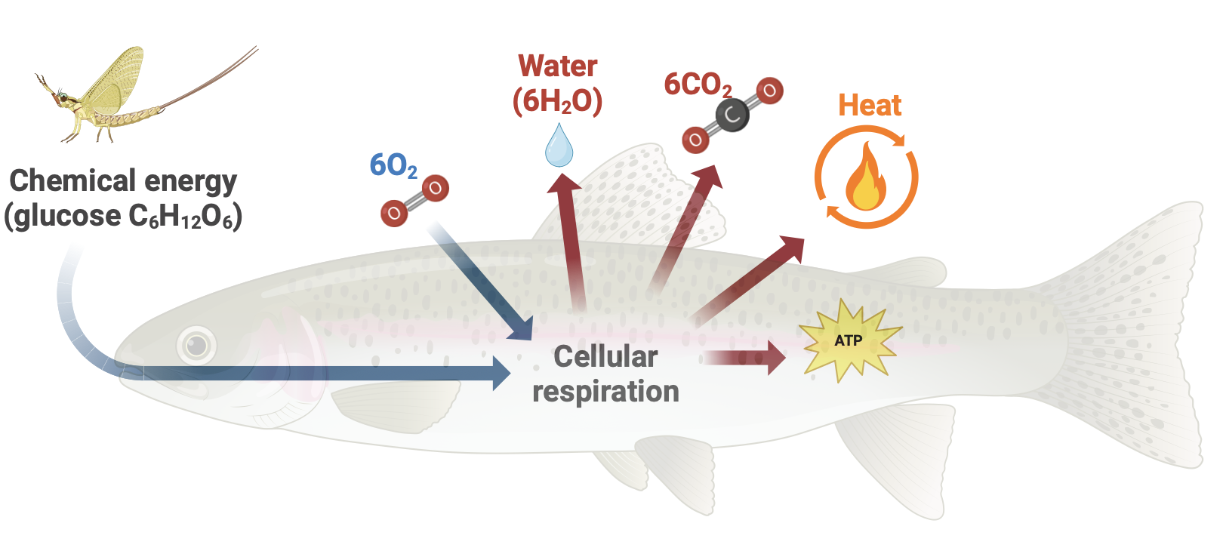
Cellular respiration
All organisms (autotrophs and heterotrophs) convert chemical energy in organic compounds into adenosine triphosphate (ATP), a molecule used for cellular processes, through a series of chemical reactions called cellular respiration.
Cellular respiration is not a completely efficient process as energy is lost as heat.

Slide 7
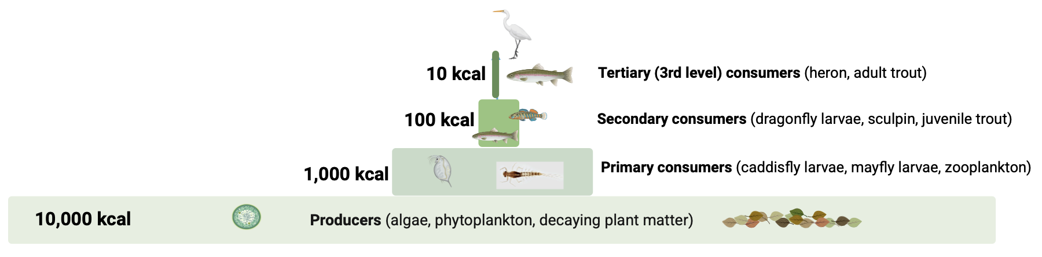
Trophic pyramid
As energy is lost during each step of the food chain, energy needs to be added to the system continuously.
Another way to model energy in an ecosystem is a trophic pyramid which shows the amount of energy (or biomass) contained within each trophic level.

Slide 8
Trophic pyramid
As much as 90% of energy is lost from one trophic level to another due to:
Heat lost through respiration
Not all organisms are consumed by the next trophic level
Not all parts of an organism are consumed (ie. hair, bones)
Not all the energy of an consumed organism is used by the consuming organism (ie. fecal loss)

Slide 9
Trophic pyramid
When drawing a trophic pyramid, it should have the following characteristics:
Horizontal bar chart
Drawn to scale and should be stepped, not triangular
All bars should be labelled by trophic level (producer, primary consumer, etc) with producers at the bottom

