Slide 1
Lesson 1.1
Introducing Ecology
www.tu.org/headwaters © 2025 Trout Unlimited. Any use of the text or images this document contains without permission of 2025 Trout Unlimited is prohibited.

Slide 2
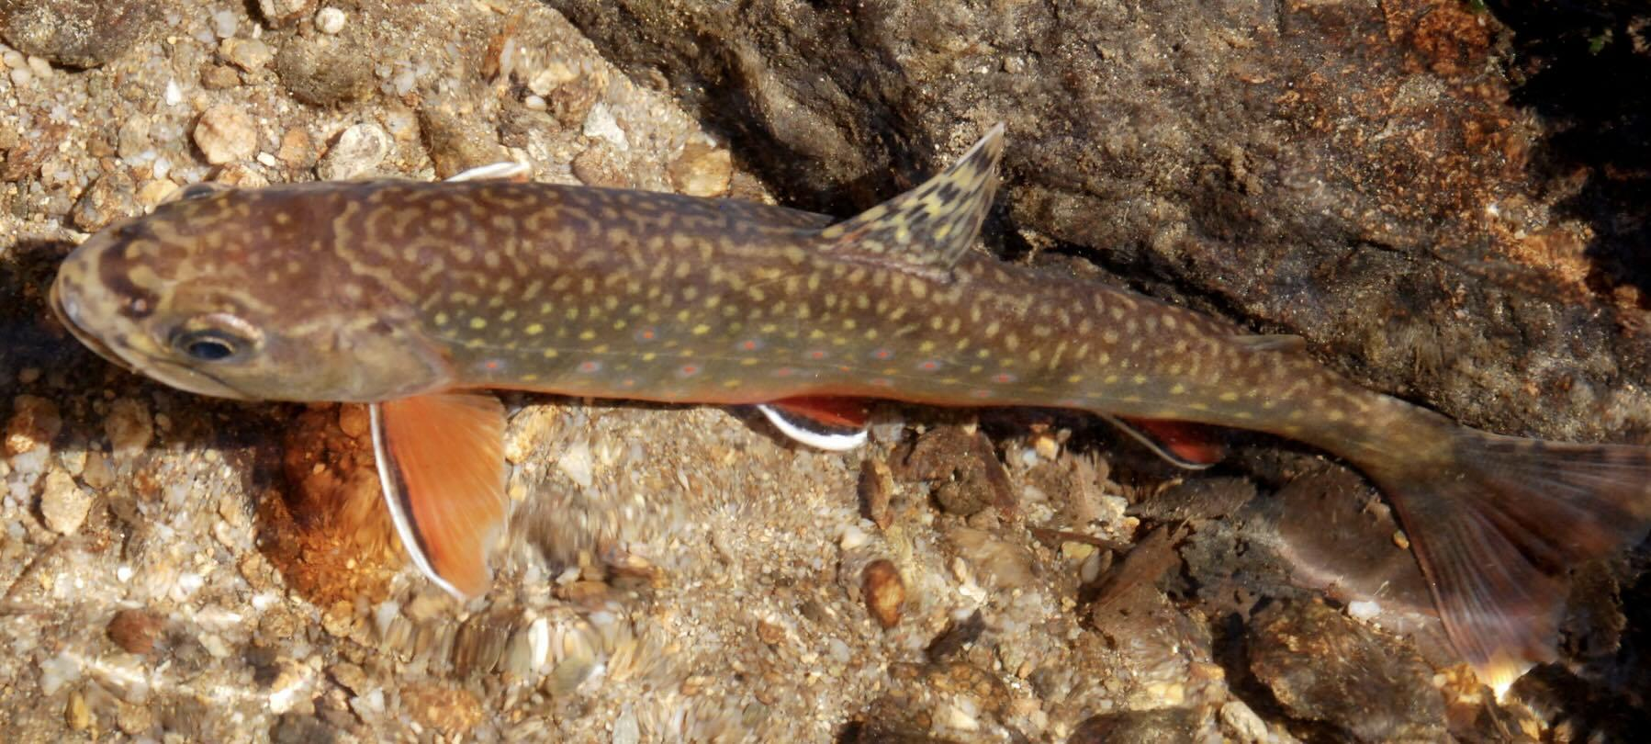
Organisms, populations, species
Organism - a living thing
Species - a group of organisms
with similar characteristics that
can potentially interbreed
and produce fertile offspring.
Note that some species can interbreed to produce hybrid offspring.
Population - a group of organisms
of the same species who
live in the same area
at the same time.
© 2014 Trout Unlimited

Slide 3
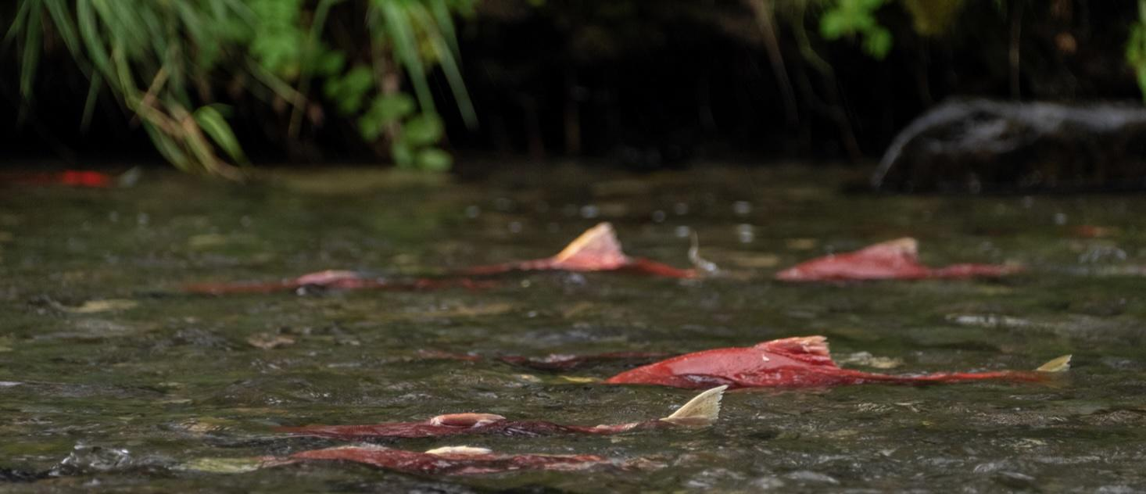
Populations, communities, ecosystems
Population - a group of organisms
of the same species who
live in the same area and time.
Community - a group of populations
of different species living together
and interacting
in a common area and time.
Ecosystem - is a
community
interacting with the abiotic environment.
© 2023 Josh Duplechian, Trout Unlimited

Slide 4
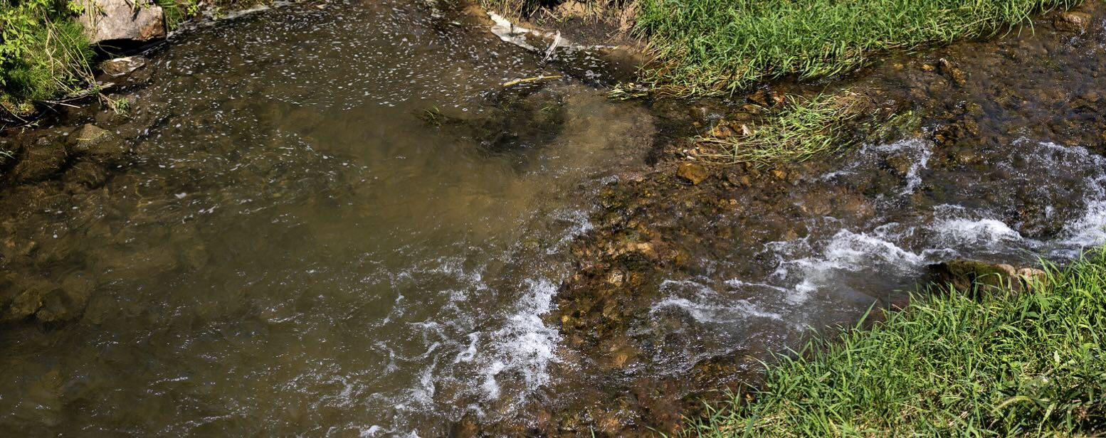
Habitat
An organism’s habitat is the physical place or environment in which it lives.
An organism’s habitat is not always of a single type. Some organisms occupy a range of habitats. Why?
© 2024 Justin Carfagnini, Trout Unlimited

Slide 5
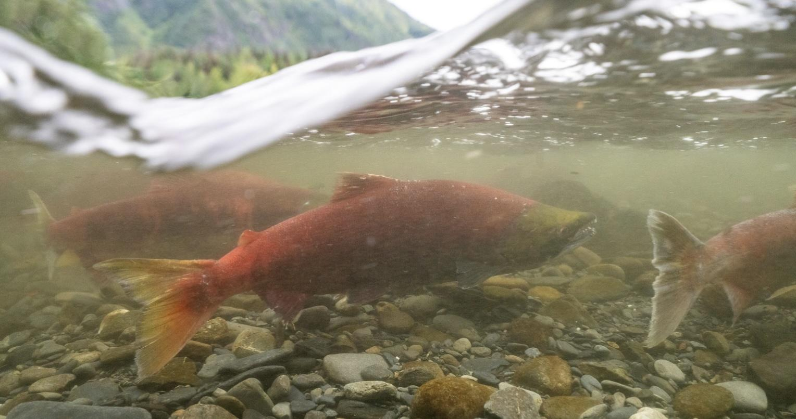
Niche
The ecological niche describes the functional role of an organism in its environment. A niche comprises:
the habitat in which the organism lives, including the physical conditions that make the habitat suitable for the organism.
the relationships or interactions with other organisms.
The competitive exclusion principle states that when two species occupy the same niche, one will dominate, causing the other to change its niche or reduce in number
© 2023 Josh Duplechian, Trout Unlimited

