Slide 1
Trout in the Classroom
Organized by
the State Council of
Trout Unlimited
Bringing nature into the classroom allows students to develop a personal bond with conservation and aquatic biology
Project Manager
Dave Leta
TU State Council
State TIC Coordinator

Slide 2
What is TIC in Utah?
Partnerships
How it works
Funding
October – December: Equipment is set up and tested
Early January: fertilized trout eggs and fish food are provided by the DWR and delivered to the classrooms by TU volunteers
January – May: Students raise the trout in their classrooms and learn about aquatic biology
May: Fingerling size trout are released to DWR approved ponds and lakes
Project requires specialized 55-gallon cold water aquariums, chillers, filters, supplies, etc.
Each aquarium setup costs approximately $1,500
Teachers and schools provide the funding from STEM funds, education foundations and private donors.
One-time cost. Properly maintained, the equipment lasts several years.
Teachers, Schools, TU volunteers and DWR
Approximately 49 Utah teachers and classrooms in 6 counties are participating now
Part of a national education effort with over 5,000 participating classrooms
High praise from teachers and students who participate.

Slide 3
TIC in Action
A few of the participating students
A Teacher’s Hydroponic Innovation

Slide 4
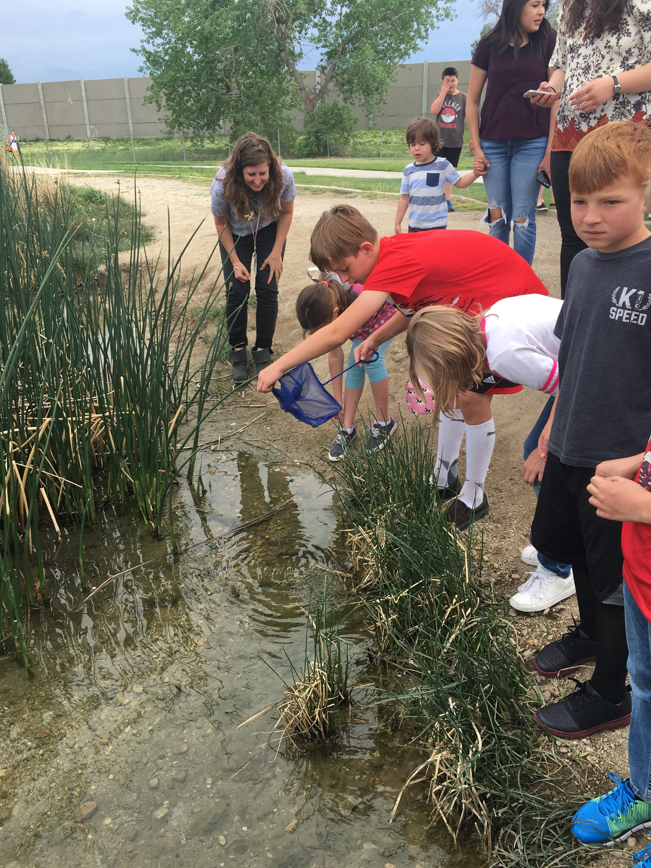
Benefits from the TIC program
Creates lifetime connections for the students between caring for fish and caring for fish habitat.
Hands-on learning experience about the environmental conditions for maintaining healthy fisheries.
A focus on understanding the life cycles of the fish
Making science come to life in a personal way.
Creating generations of conservationists and fishing enthusiasts.

Slide 5
Equipment

Slide 6
Additional Information and Resources
https://www.troutintheclassroom.org/

